Slide 1
Chair Pose
Utkataasana
Benefits
Strengthens legs, stretches shoulders and chest.
1
Start in mountain pose. (Standing with your feet shoulder width apart and arms by your side).
Exhale, and bend your knees as if you were sitting in a chair.
Reach your arms towards the ceiling with your palms facing each other.
Hold this pose and breathe.
2
3
4

Slide 2
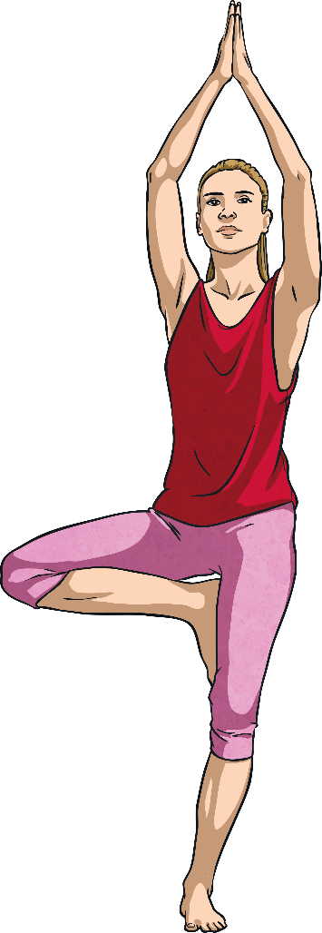
Tree Pose
Vriksasana
Benefits
Improves balance, strengthens thighs, calves and ankles, stretches legs and chest, develops concentration.
1
Begin in mountain pose. (Feet shoulder-width apart, hands at your sides.)
Lift your right foot, turning your knee out; place your foot on your leg wherever feels comfortable.
Press your hands together.
Raise your arms over your head and look up to your hands if possible.
Return hands to your chest and lower your right leg.
Repeat with left leg.
2
3
4
5
6

Slide 3
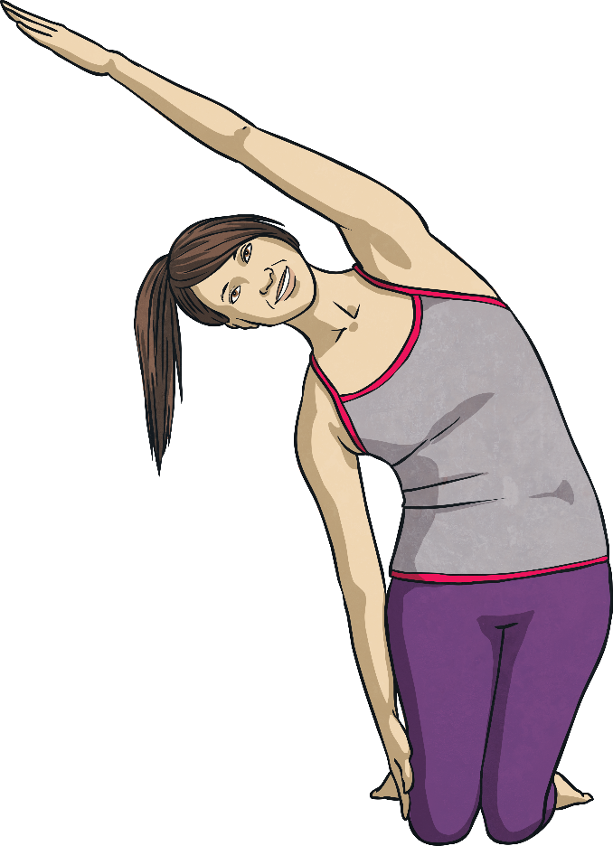
Rainbow Pose
Benefits
Stretches arms, abdominals, spine and chest; calms the mind.
1
Start on your knees. Raise both hands over your head.
Drop one hand by your side, exhale and arch your arm over your body.
Hold this position.
As you bring your dropped arm back over your head, straighten your body.
Repeat on the other side.
2
3
4
5

Slide 4
Elephant Pose
Benefits
Stretches legs and back, relieves stress and calms the mind.
1
Bend at the hips.
Let arms hang low then clasp fingers together.
Swing arms from side to side like a trunk. Swing your whole body from side to side to walk like an elephant.
2
3

Slide 5
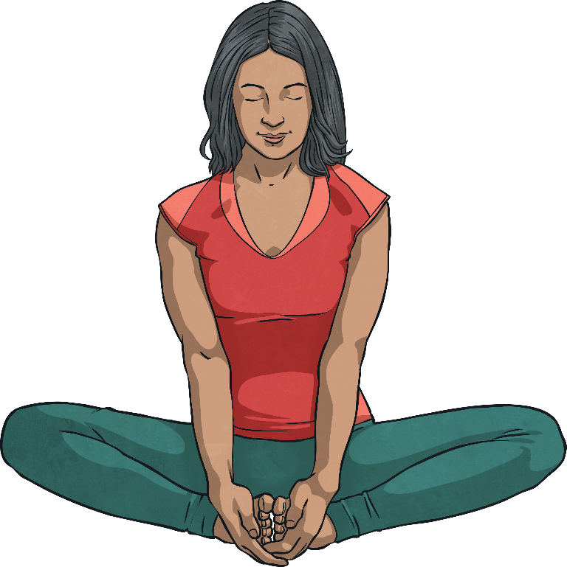
Butterfly Pose
Baddha Konasana
Benefits
Calms the body and mind, helps relieve stress, headaches and fatigue.
1
Begin by sitting with the soles of your feet together.
Wrap your hands around your feet, keep your back straight.
Gently bounce your knees to flap your butterfly wings.
2
3

Slide 6
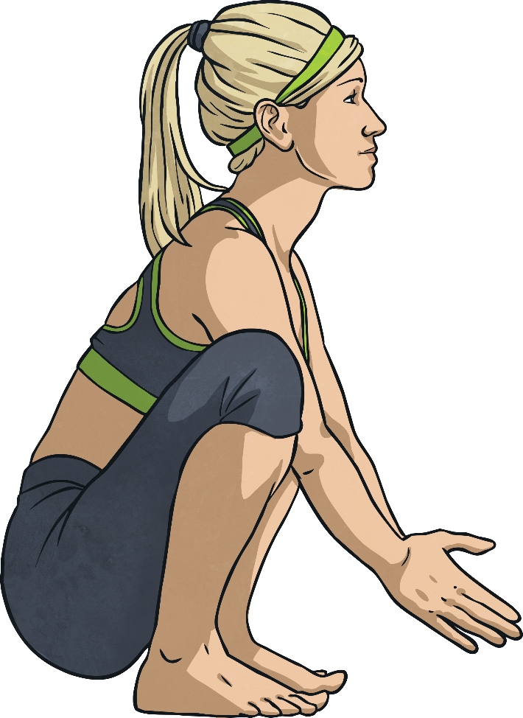
Frog Pose
Ardha Bhekasana
Benefits
Tones legs and increases hamstring flexibility.
Squat on the floor, balancing on your toes, knees spread wide, hands on the floor or out in front of you. Wherever makes you feel most balanced.
Look up and inhale. As you exhale, straighten your legs so you are in a standing position, lower your head towards your knees.
Return to the first position, then repeat.
1
2
3

Slide 7
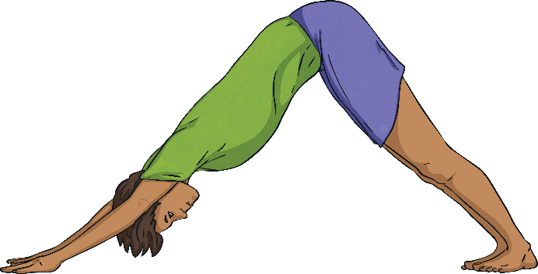
Downward Dog
Benefits
Stretches the shoulders, hamstrings, calves, arches and hands; calms the mind.
1
Start on your hands and knees, with your knees slightly apart, directly under the hips.
Your hands should be shoulder-width apart, and slightly in front of your shoulders.
Curl your toes under, straighten your knees and lift your hips.
Keep your head between your arms.
Hold this pose and breathe.
2
3
4
5

