Slide 1
WORLD BOOK DAY
MATHS QUIZ

Slide 2
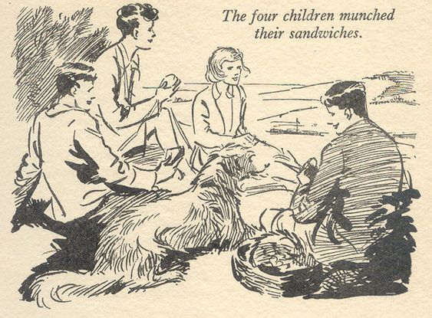
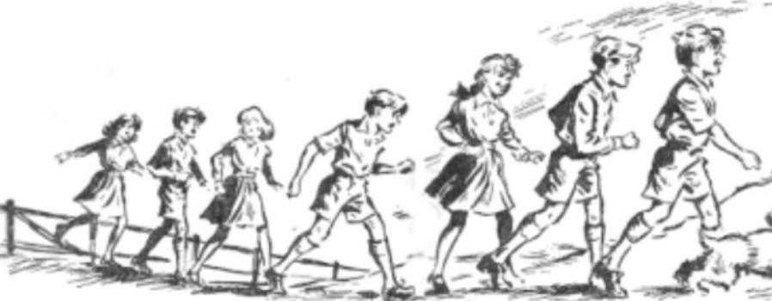
QUESTION 1
If the Secret Seven and the Famous Five all went to buy new school shoes together, how many school shoes would they need?

Slide 3
QUESTION 2
Miss Laitl and Mrs Blomeley are both reading books.
Miss Laitl’s book has 350 pages inside.
Mrs Blomeley‘s book has 225 pages inside.
How many pages will they read altogether?

Slide 4
QUESTION 3
Harry Potter travels to Hogwarts on a train from Platform 9 and ¾.
Which of these is NOT an equivalent fraction to ¾?
12/24
9/12
30/40
18/24

Slide 5
QUESTION 4
How would you write 9 and ¾ as an improper fraction?
Can you draw it as a bar model?

Slide 6
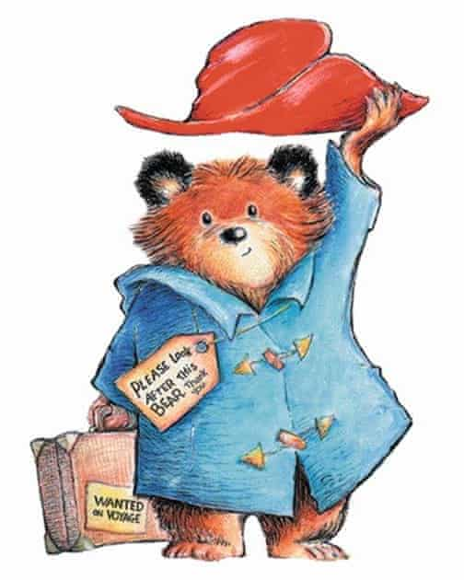
QUESTION 5
Paddington Bear was born in 1956.
He has two birthdays (like the Queen), one is on the 25th December and the other is on the 25th June.
How old is he today?

Slide 7
QUESTION 6
Read this extract from The Twits by Roald Dahl.
“A person who has good thoughts cannot ever be ugly. If you have good thoughts they will shine out of your face like sunbeams and you will always look lovely.’’
What fraction of the words are adjectives?

Slide 8
QUESTION 7
There are 85 Mr Men and Little Miss characters.
If the characters were to split into 5 classes at Broadbent Fold Primary School, how many would be in each?

Slide 9
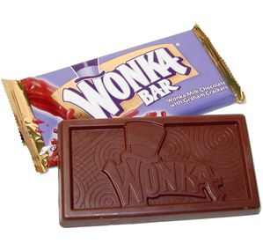
QUESTION 8
If Willy Wonka makes 50 bars of chocolate in a day, how many bars would he make in…
A) A week?
B) A month?
C) A year?

Slide 10
QUESTION 9
Little Red Riding Hood bakes 60 cupcakes. The wolf steals half of them.
A) How many are left for Little Red to share with her Grandma?
B) How many do they get each if they share them equally?

Slide 11
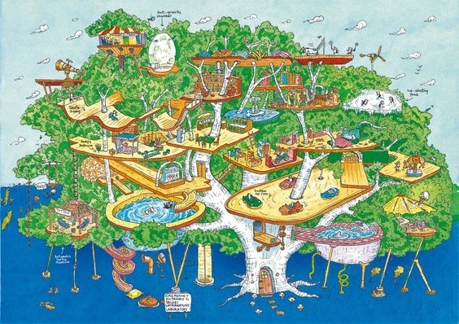
QUESTION 10
If the 13 Story Tree House finishes up as 130 Story Tree House, how many NEW stories have been built?

Slide 12
QUESTION 11
The tree in the Magic Faraway Tree grows an average of 8cm a day.
How many cm does it grow in 12 days?

Slide 13
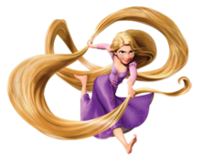
QUESTION 12
If Rapunzel’s hair was 23m long and the witch chopped off 15m, how much is left?

Slide 14
QUESTION 13
The school cook used 500g of chocolate to make a cake for Bruce Bogtrotter.
She used 3 times as much butter and 4 times as much flour.
How many grams of each did she use?

Slide 15
QUESTION 14
The wardrobe in The Lion, the Witch and the Wardrobe is 45cm deep.
It is 3 times as tall as it is deep.
How tall is it?

Slide 16
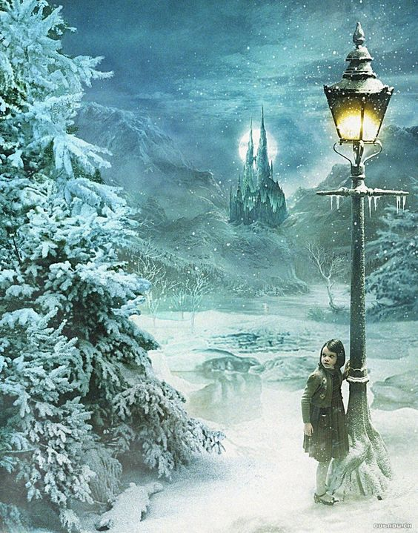
QUESTION 15
1 hour in England is 5 hours in Narnia time.
How many hours are there in a Narnia day?

Slide 17
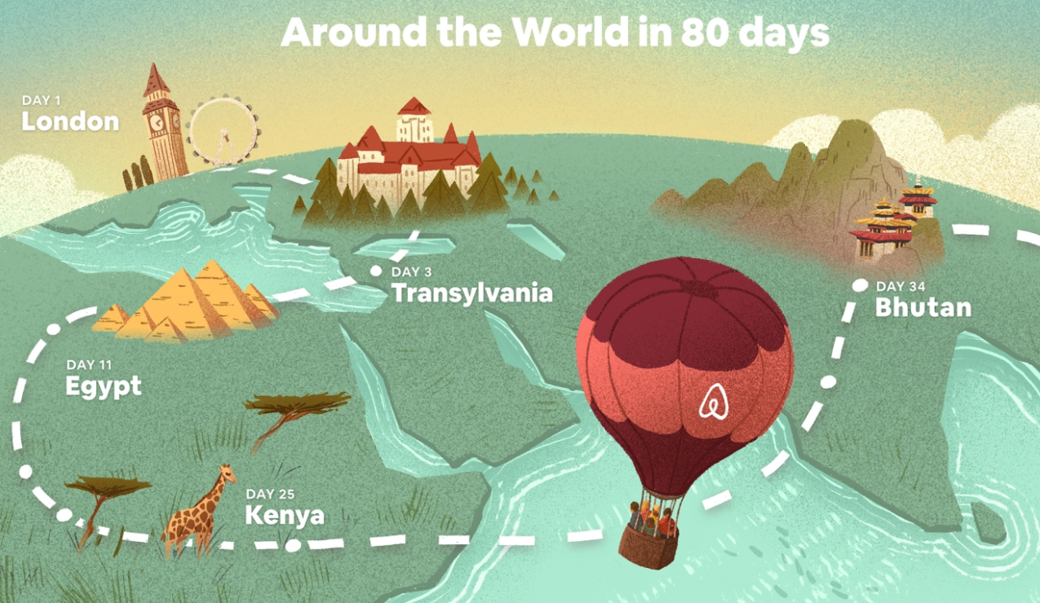
QUESTION 16
Around the world in 80 days, how far would he have travelled as a fraction in 20 days?

Slide 18
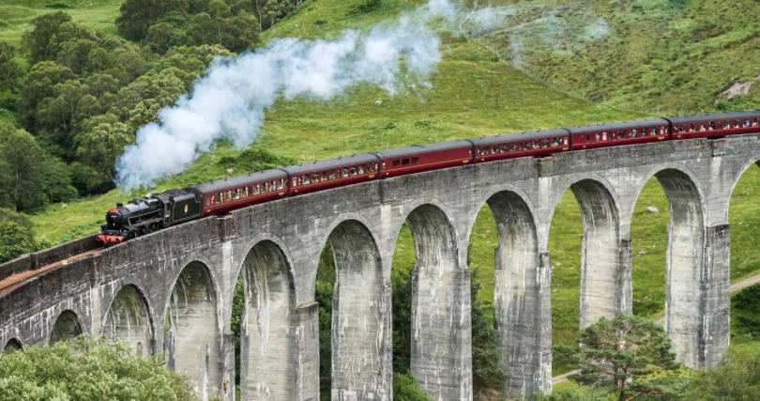
QUESTION 17
If the Hogwarts express can hold 24 children in each carriage, how many children are there in 7 carriages?

Slide 19
QUESTION 18
If the firework maker makes five boxes of fireworks each with seven fireworks inside, how many fireworks has he made altogether?

Slide 20
QUESTION 19
George's Marvellous Medicine Recipe:
100g Golden Syrup
200g Shampoo
500g Hot Chilli Sauce
50g Wax Polish
How much altogether?
Give your answer in kilograms

Slide 21
QUESTION 20
What would Mr Wolf’s dinner time be on a 24 hour clock if it was at 1pm?

Slide 22
QUESTION 21
Little Red Riding Hood set off for Grannie’s house at 9:15am and arrived 25 minutes later.
What time did she arrive?

Slide 23
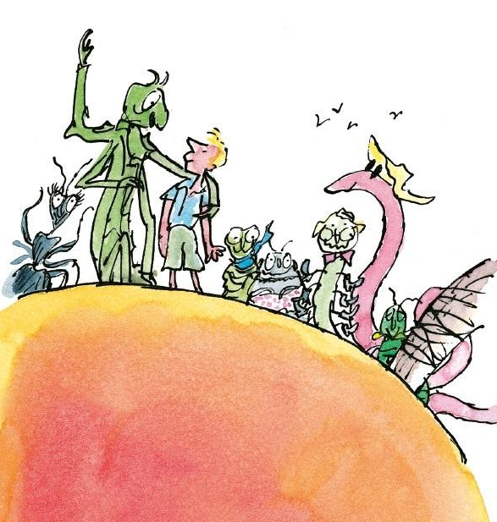
QUESTION 22
The ladybird has a peach that is 190cm tall, James has a peach that is 2m and 30cm tall.
Grasshopper's peach is exactly halfway between ladybird's and James' peach.
How tall is grasshoppers peach?

Slide 24
QUESTION 23
Mr Slow’s friends were throwing him a birthday party.
The party was due to start at 13:15, his friends told him that it started 30 minutes earlier so that he would not be late!
What time did they tell Mr Slow?

Slide 25
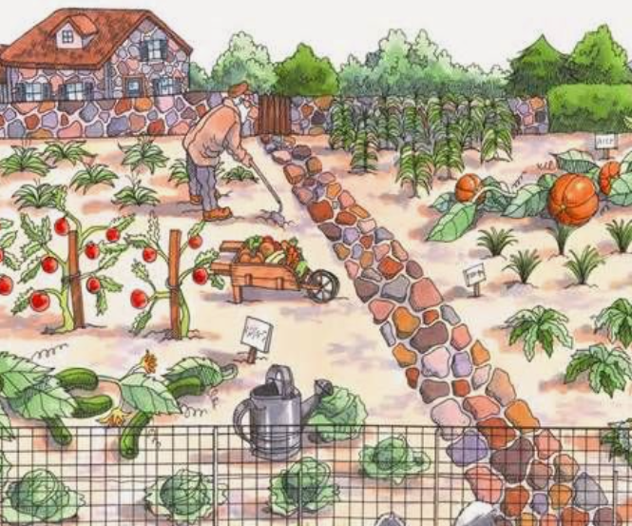
QUESTION 24
y
What are the coordinates for the wheelbarrow in Mr McGregor's garden?
4
3
2
1
0
x
0 1 2 3 4 5

