Slide 1
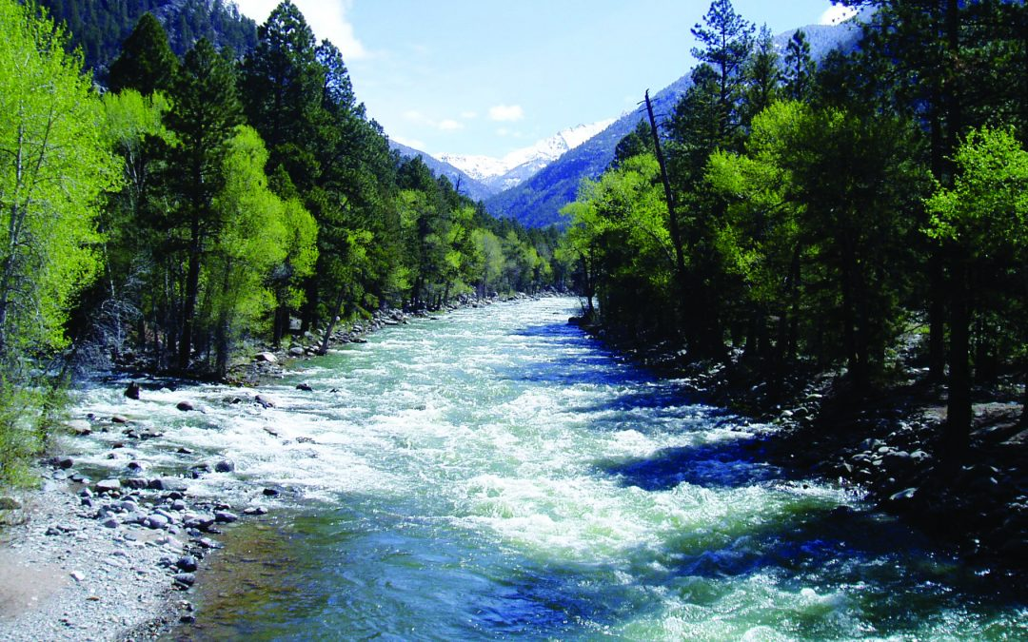
Rivers
By Lily Bowker Y5

