Slide 1
Most important rivers in the world
All river are important to humanity but here are the 5 most important in the world:
Ganges, Danube, Yangtze River, Nile and the Amazon River.
The 1,560-mile Ganges located in western Himalayas , India and has been considered the holy river. The 1771-mile Danube river is one of the most important in Europe after the Volga. Its located in Budapest. Yangtze river is one of the most important rivers in the word. Located in China it’s the longest there and the third longest in the world. The Nile that starts in Egypt and stretches to Burundi and is and is 4130 miles. And finally the Amazon the largest in the world by volume.

Slide 2
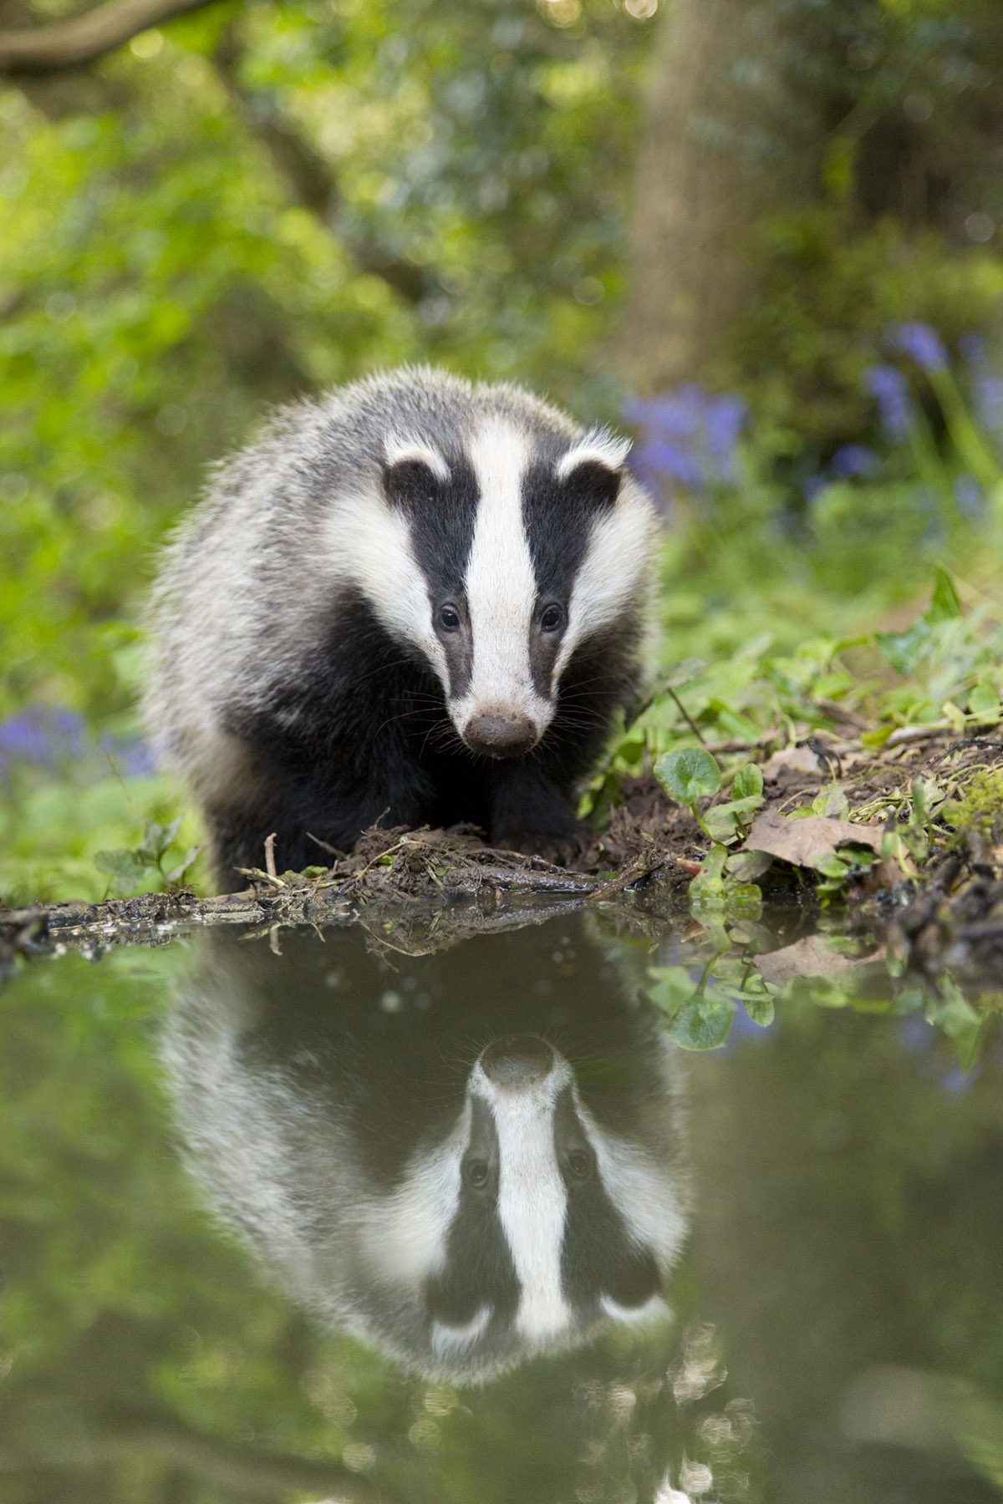
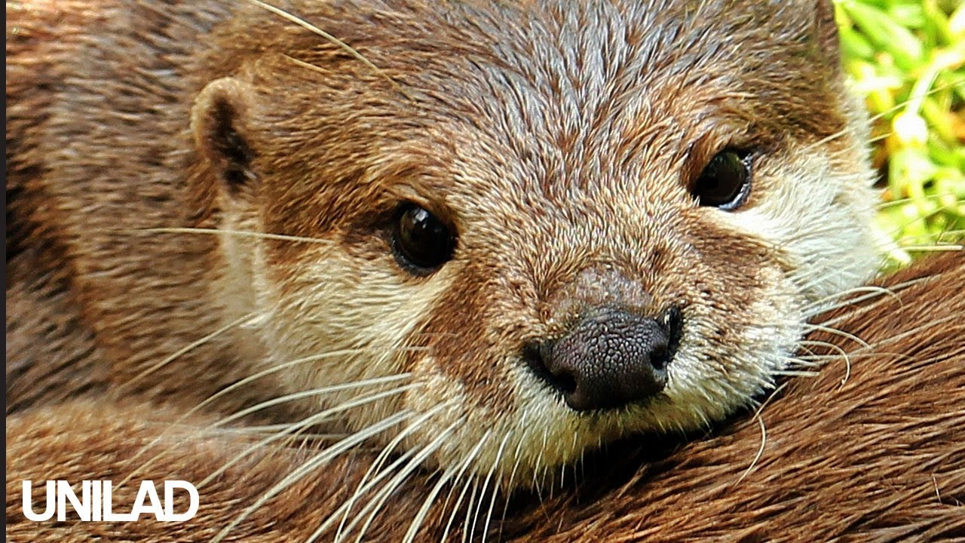
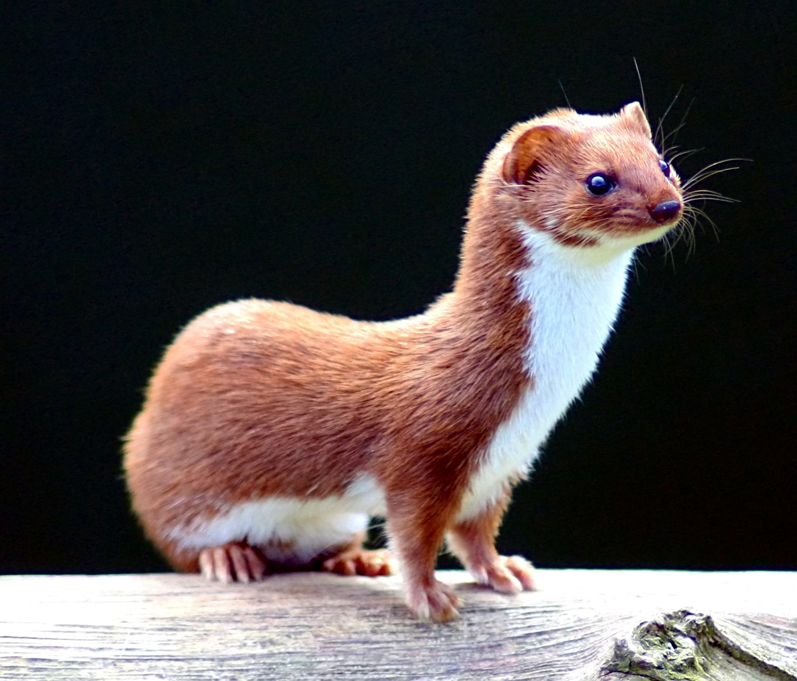
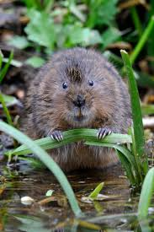
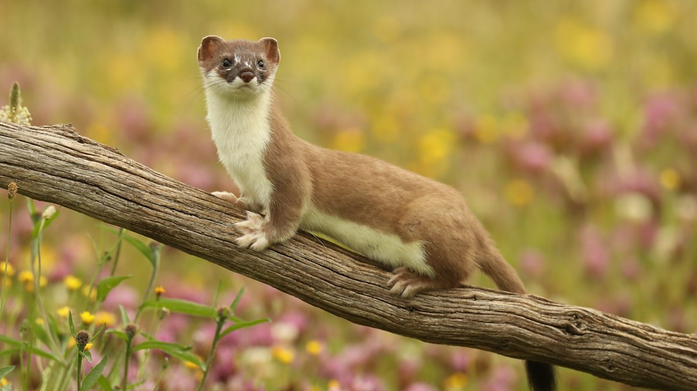
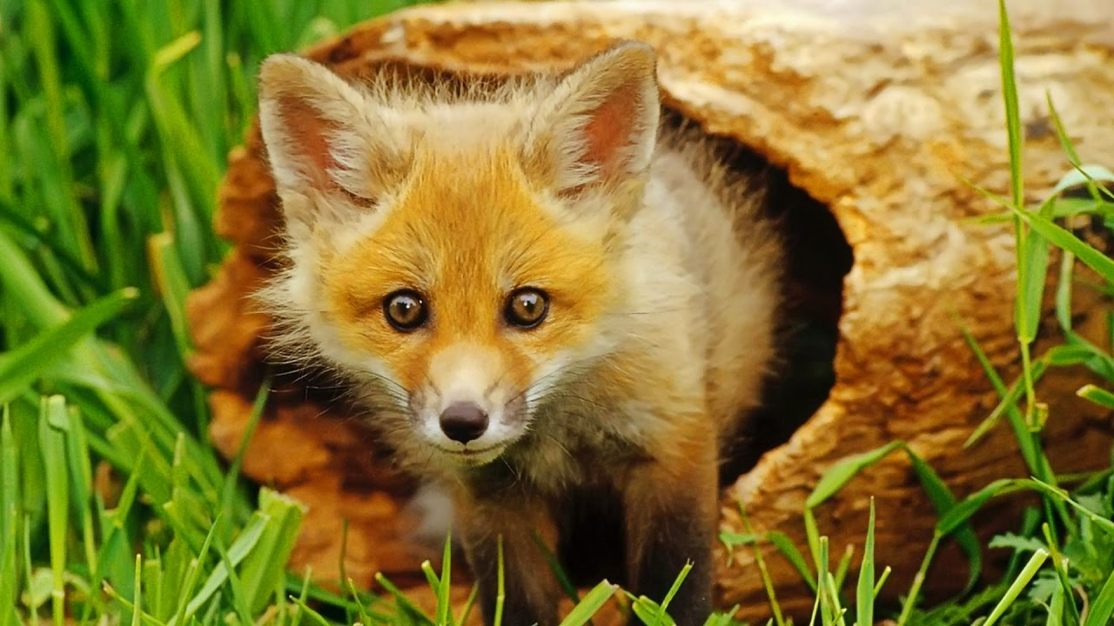
Cool facts about rivers
Rivers are found on every continent so all types of land.
Some can just be kilometers but some can be the span of a continent
The congo river is the deepest river in the world measuring 220 metres deep.
Animals you could see are a Water vole, an otter, a badger, a stoat, a weasel,a fox and lots more.

Slide 3
How rivers effect us today
They give us clean fresh water
There a habbitat for our animals
Wild rivers can provide flood protection
Wild rivers support the enire web of life
We need rivers for everyday life if we didn’t have them, we could lose precious widlife

