Slide 1
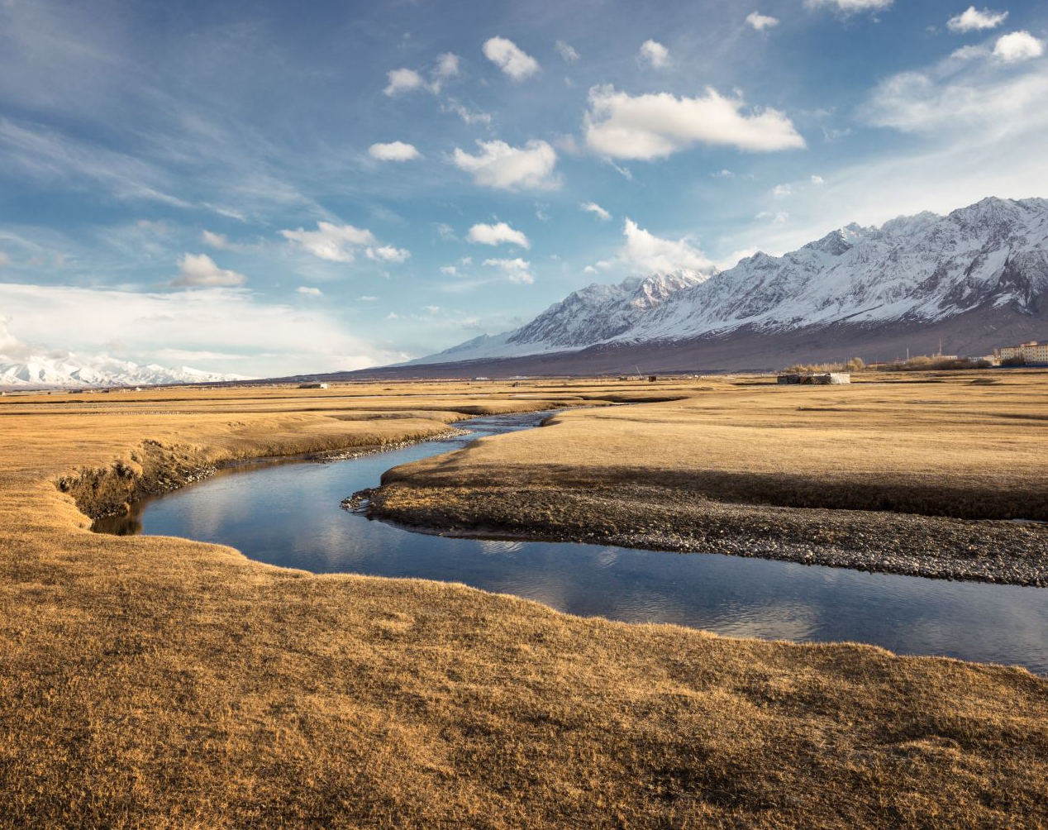
How rivers are made
Most rivers begin as a tiny stream running down the side of a hill or mountain. The water comes from rain, melted snow or ice. The water goes through the cracks in the side of hill/mountain. Then the small streams join up with other streams and head down to the bottom of the hill and join the river to make it bigger.

