Slide 1
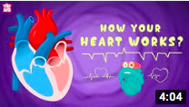
NETFLEX
Daily physical activity is very important to help keep a healthy mind and body during this difficult
time. Click on an image below to try a workout.
Healthy body = healthy mind
Our bodies
Our bodies
Healthy eating
@Miss_Wiggin

Slide 2
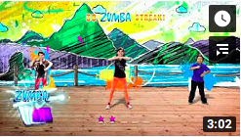
NETFLEX
Daily physical activity is very important to help keep a healthy mind and body during this difficult
time. Click on an image below to try a workout.
Healthy body = healthy mind
HP & SW workout
Dance
Aladdin
Mindfulness
@Miss_Wiggin

