Slide 1
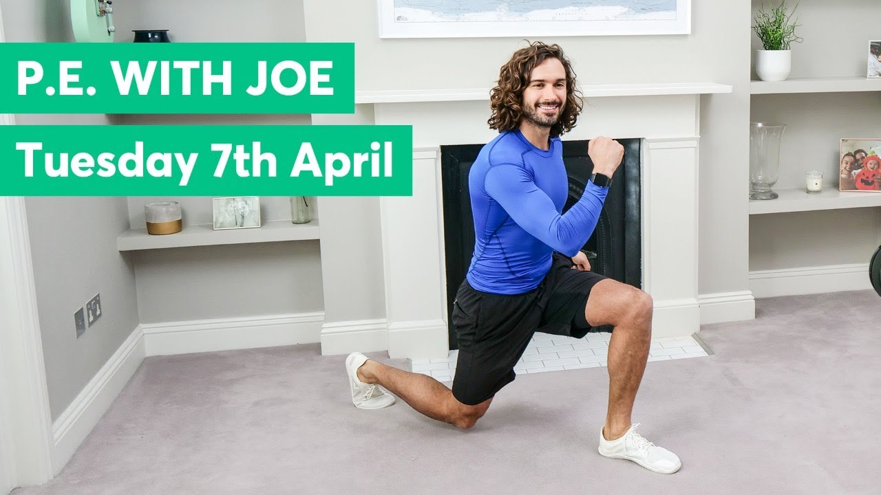
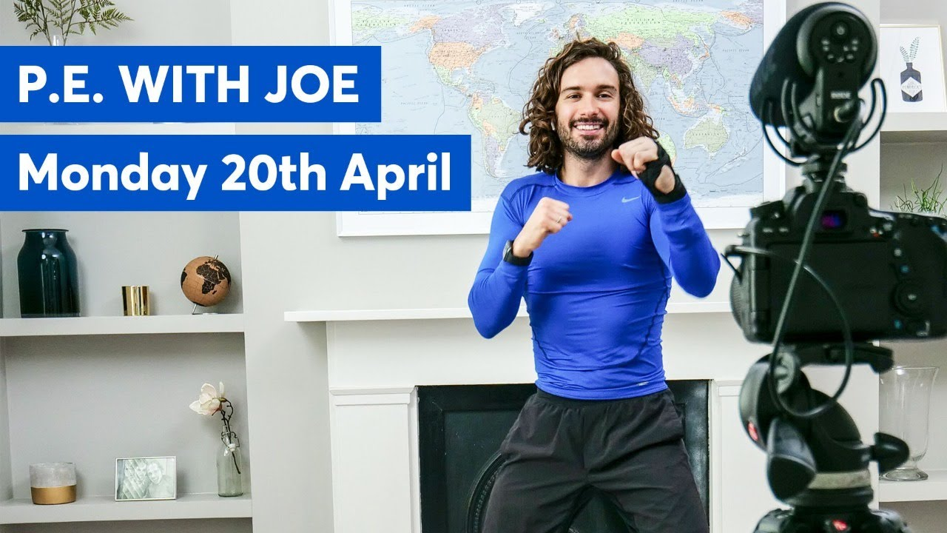
NETFLEX
Daily physical activity is very important to help keep a healthy mind and body during this difficult
time. Click on an image below to try a workout.
Healthy body = healthy mind
P.E. with Joe
P.E. with Joe | Week 1
P.E. with Joe | Week 2
P.E. with Joe | Week 3
P.E. with Joe | Week 4
P.E. with Joe | Week 5
Superhero workout
Yoga
@Miss_Wiggin

Slide 2
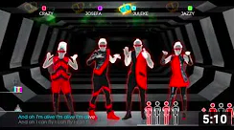
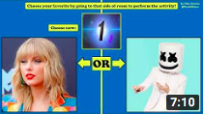
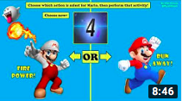
NETFLEX
Daily physical activity is very important to help keep a healthy mind and body during this difficult
time. Click on an image below to try a workout.
Healthy body = healthy mind
Just dance
Fitness fun
PE at home: challenge
@Miss_Wiggin

