Slide 1
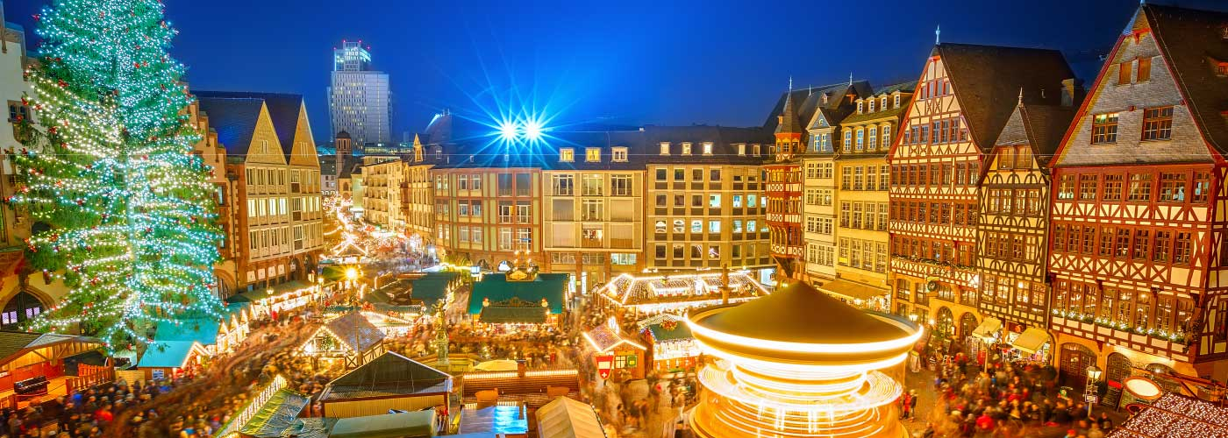
Christmas in Germany
Matthew Sibson

Slide 2
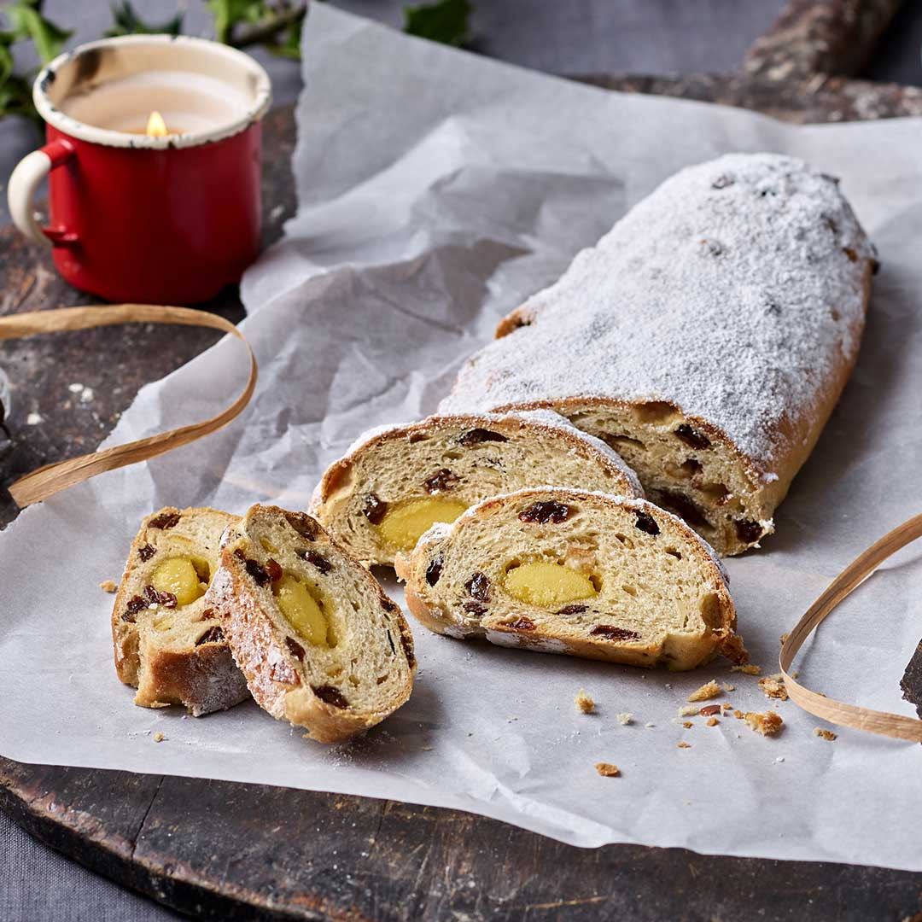
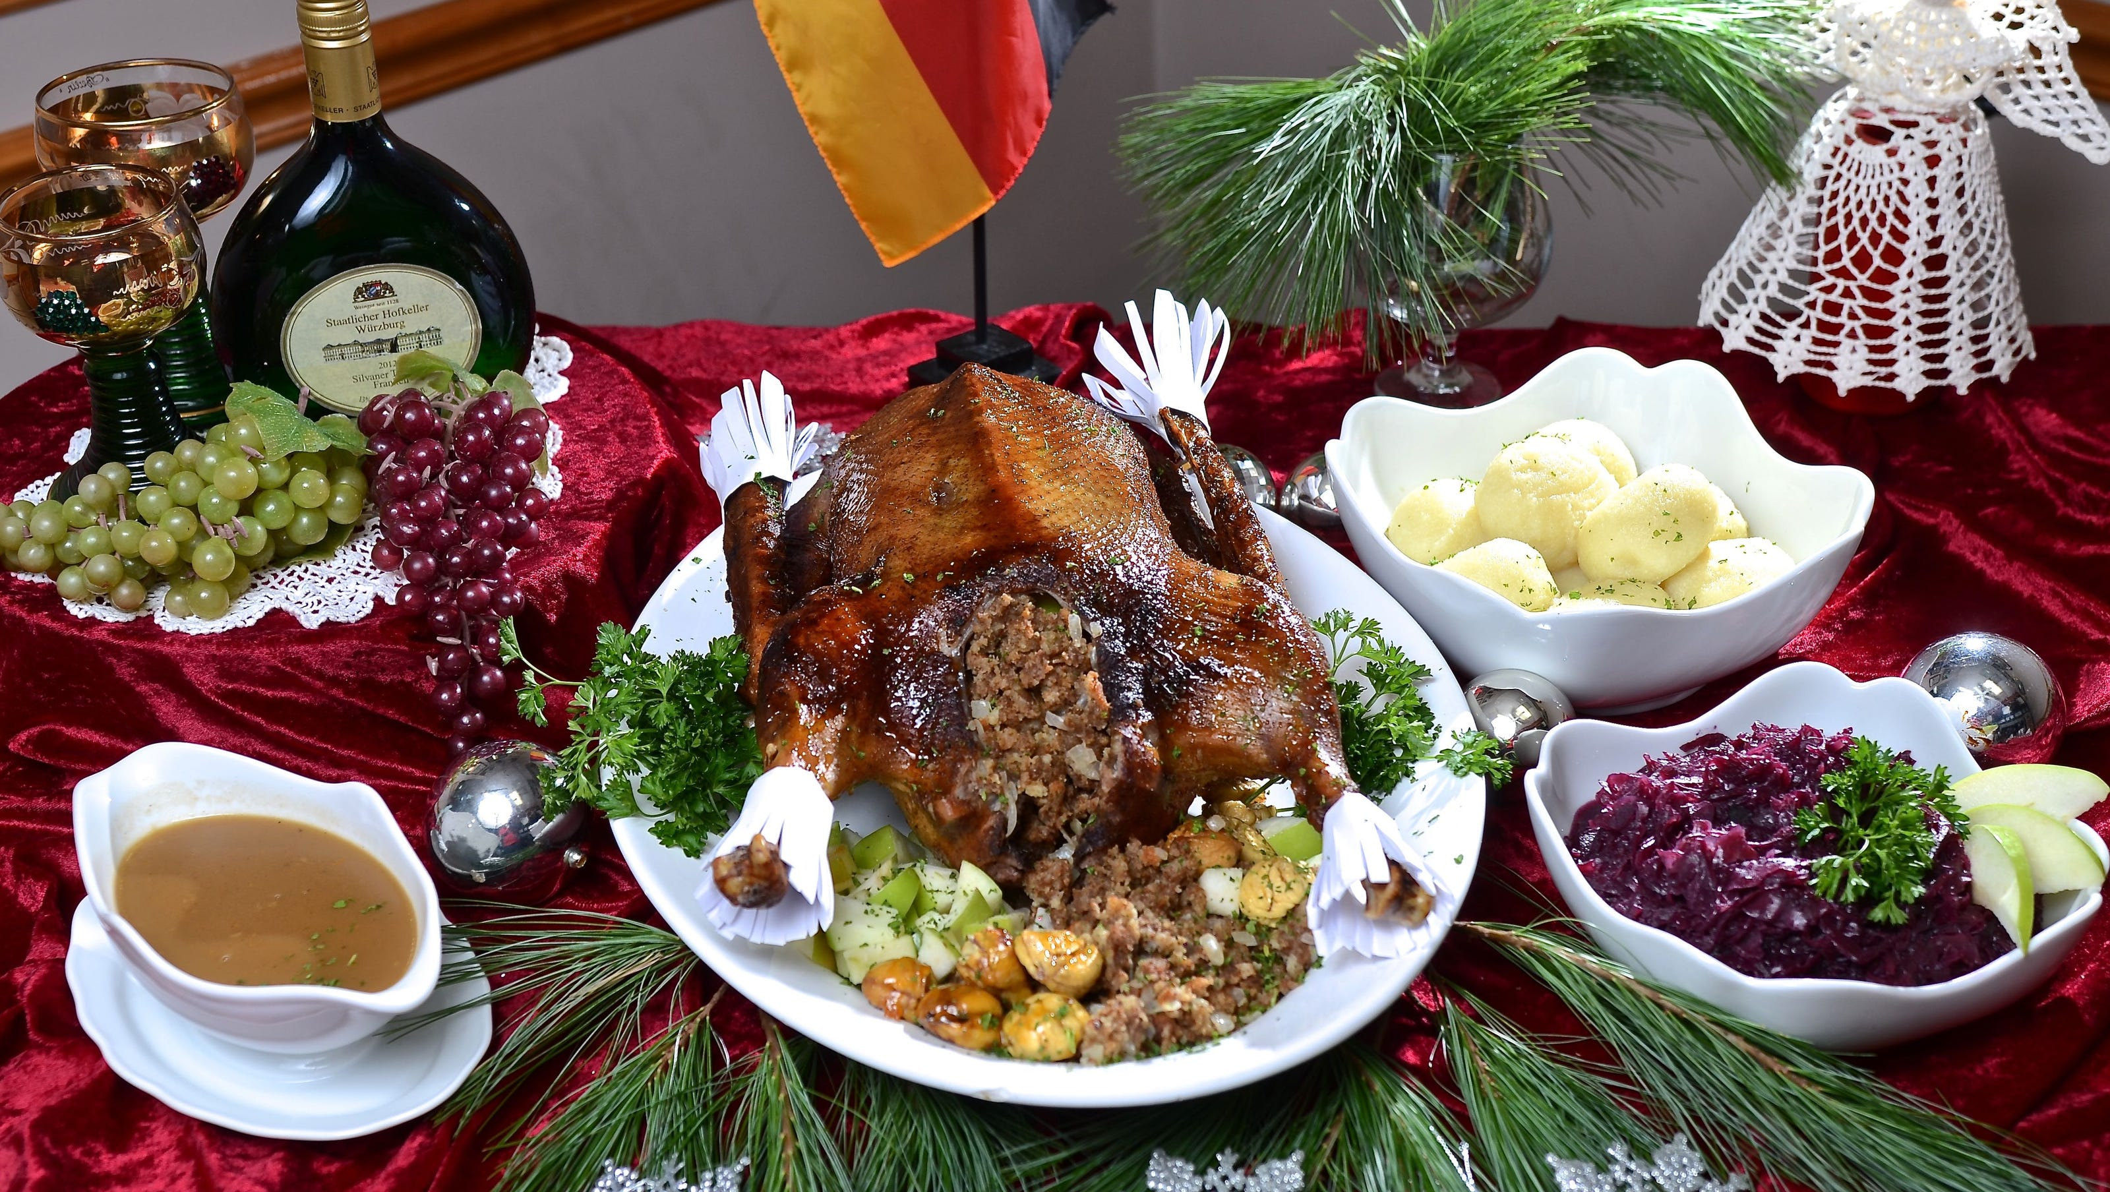
What do Germans eat at Xmas?
Stollen
Goose

Slide 3
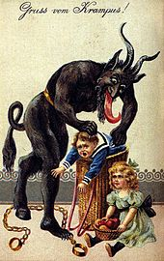
German traditions - Krampus
In Germany all the bad children are told that they must be good or on the 5th December (Monday) Krampus will visit them and scare them.
Krampus is horned, hairy and has fangs.

Slide 4
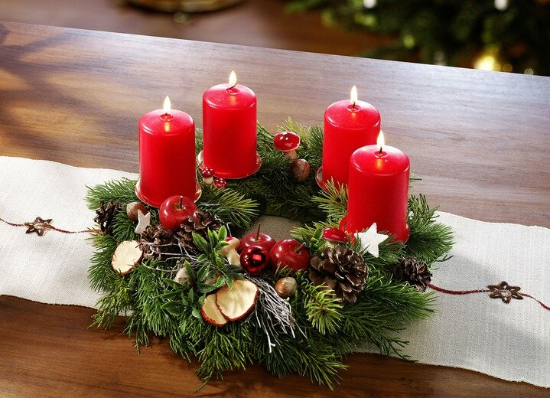
Decorations
Adventkranz
Scherenschnitte

