Slide 1
Christmas in Mexico
By Layla Snape

Slide 2
Introduction
Today i'm going to tell you a little about Mexico and how they celebrate Christmas.
Country name
Continent
Hemisphere
Closest sea
Is it landlocked
Capital city
Language
Highest mountain
Longest river
Christmas tradition

Slide 3
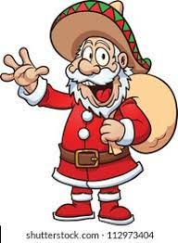
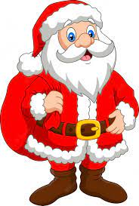
Santa
Santa Claus is known as Santo Clos

Slide 4
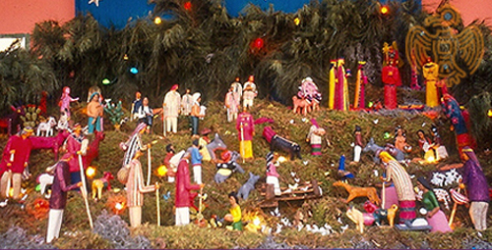
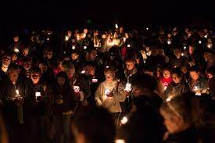
Christmas Traditions in Mexico
They do a lot around the Nativity.
Candlelit processions.
Spanish Christmas carols.
Dancing.
Fireworks.

Slide 5
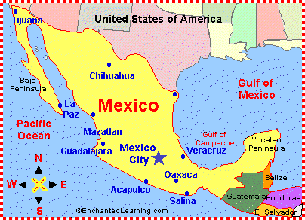
Mexico
Mexico is in North America.
Mexico is in the Western Hemisphere
It has an Ocean either side The Pacific Ocean and the Gulf of Mexico.
The most commonly spoken language is Spanish which is spoken by 90% of the people.

Slide 6
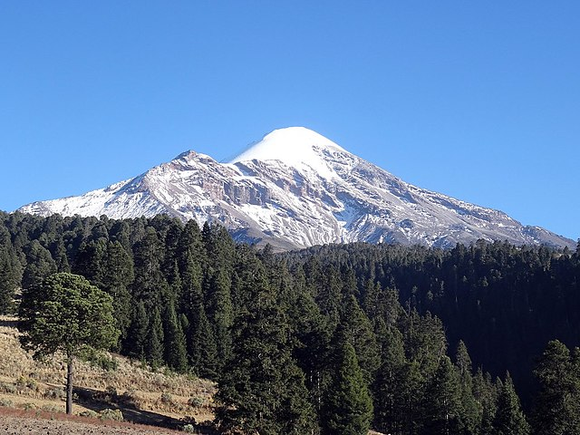
Mexico
Its Capital City is called Mexico City
It has several long rivers the longest being the Rio Grande 1921 miles long.
Its highest mountain is 5636m and called the Pico de Orizaba.

Slide 7
Merry Christmas
Have a great Christmas i hope you enjoyed my presentation.

