Slide 1
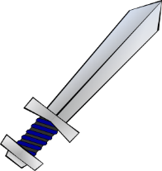
What is a kenning?
A kenning is a concise compound or figurative phrase replacing a common noun.
It comes from the Anglo Saxon era, where swords had names like ‘death bringer’ or ‘wound maker’. Or an axe might be a ‘skull splitter’.

Slide 2
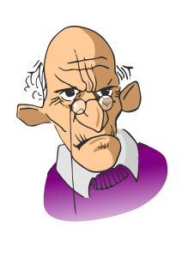
Let’s see if we can write some kennings about another member of the family – our Granddad.
creaks
snores
creaker
snorer
hogs
hogger
shouts
shouter
chews
chewer
We need to begin by making a list of what our Granddad does. Our verbs
helps
Now change these to ‘er’ words.
helper

Slide 3
Next we need to add an interesting detail to each of our ‘er’ words.
armchair hogger
toffee chewer
where’s my dinner shouter
old bones creaker
all day snorer
history homework helper
So, we might get …

Slide 4
Now we can put these into couplets to begin our kennings poem.
Kennings For Granddad
armchair hogger
toffee chewer
all day snorer
where’s my dinner shouter
old bones creaker
history homework helper
Let’s call it ‘Kennings For Granddad’.

