Slide 1
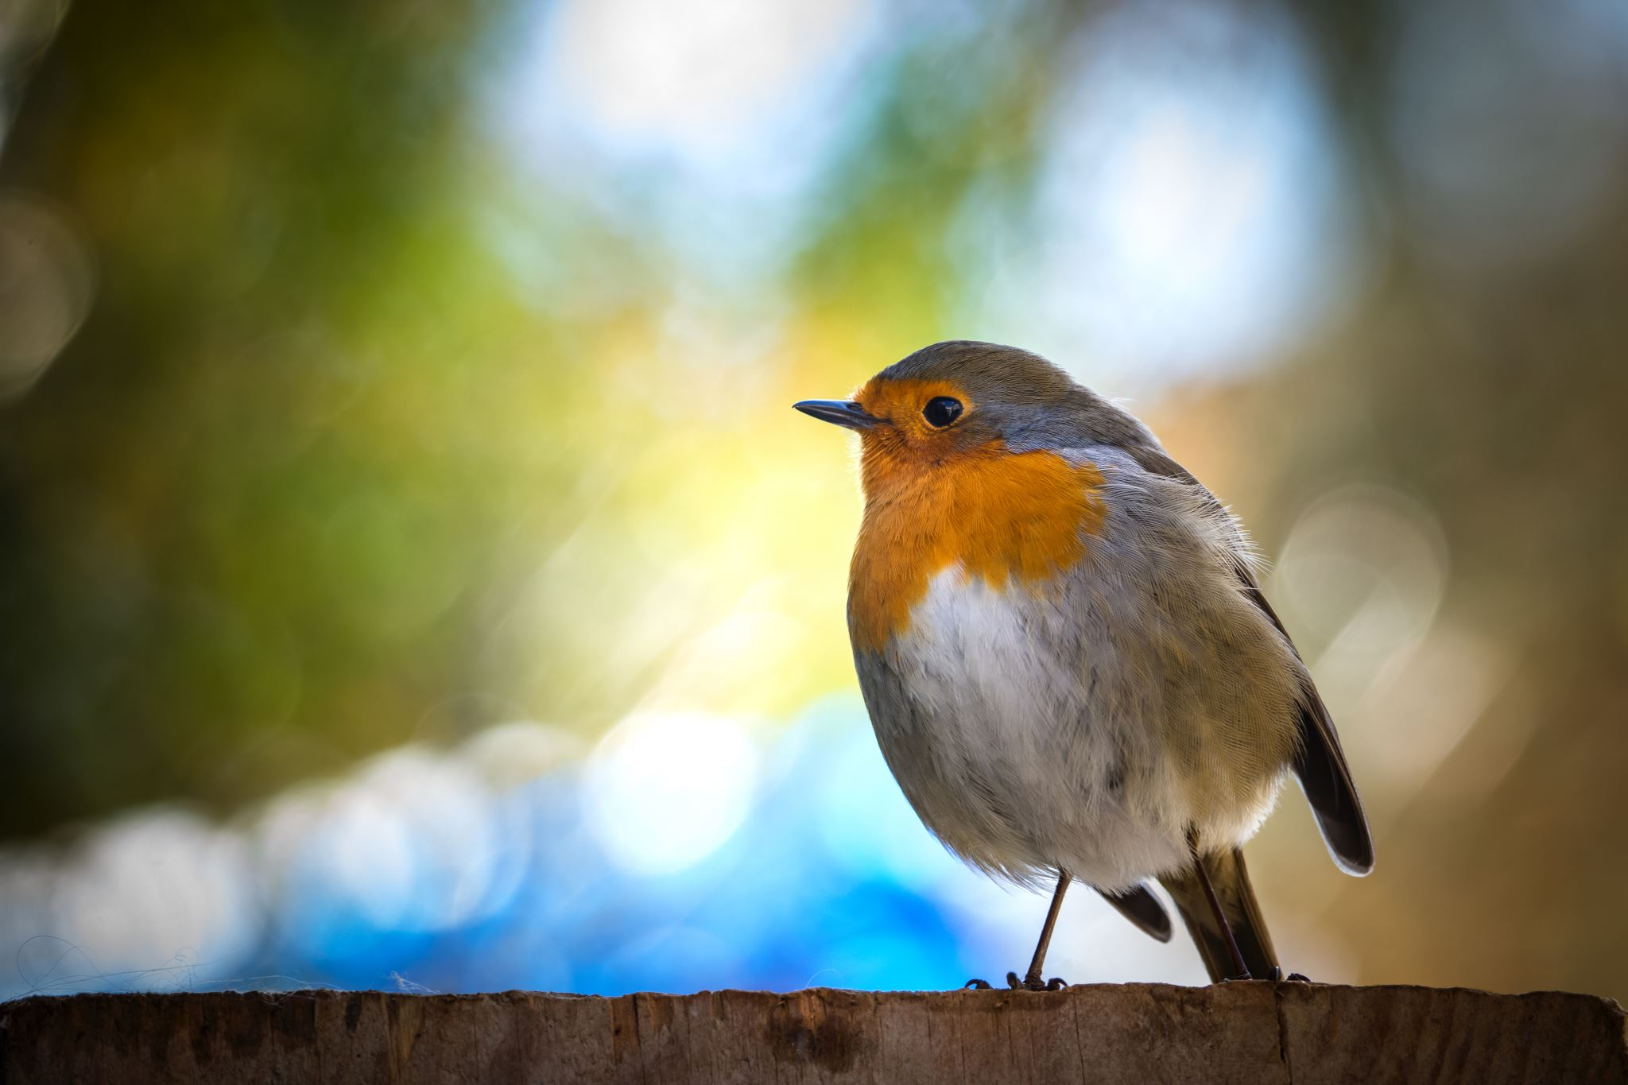
Primary Forest School
Online Learning – Big Schools/garden Birdwatch

Slide 2
Did you know about…?
Click Here for More Information

Slide 3
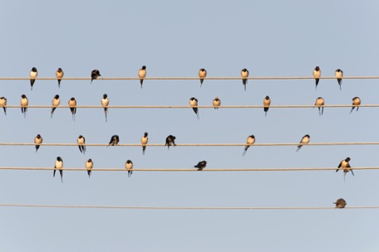
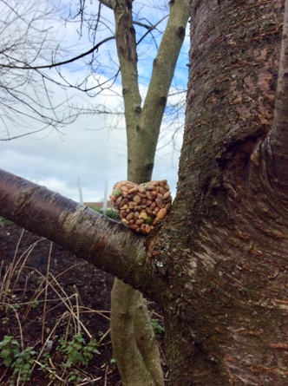
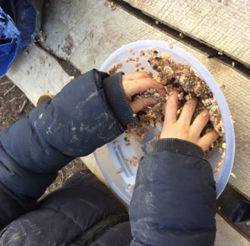
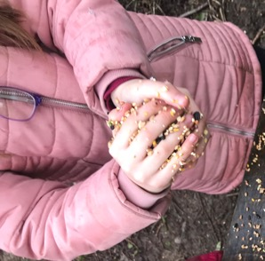
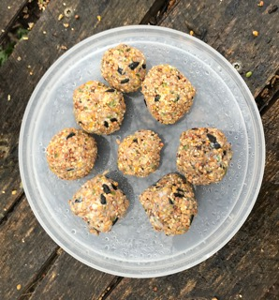
Be our Guest!
How to make Fat Balls;
Top Tip: Use cookies cutters to make different shapes!
Step 1: Soften the fat – whether it’s lard or left over (cooled) cooking fat
Step 2: Mix the fat with the bird seed/ old cereal. You should have no fat blobs – it should all be mixed with the seeds especially inside the ball!
Step 3: Use your hands to make into a ball shape
Step 4: Put outside (off the ground) and wait for any visitors

Slide 4
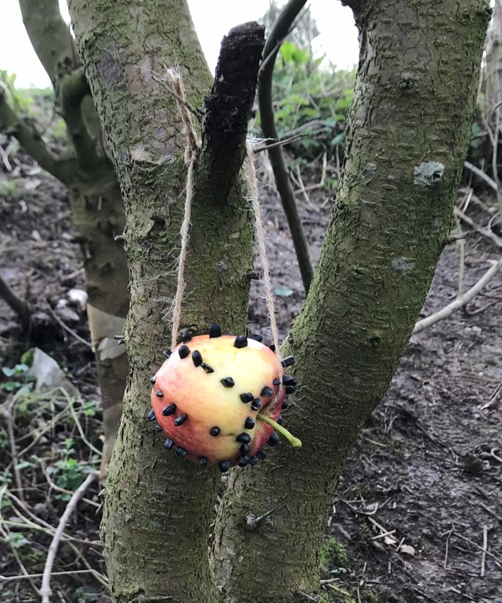
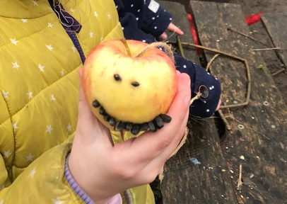
Still a little peckish?
How to make an apple feeder;
Step 1: Get an apple and some sunflower seeds
Step 2: Using the pointy end of the sunflower seed push them into the apple. Add as many seed as possible to your apple!
Step 3: Attach sting to the stalk or place on bird feeder table
Can you make a pattern on your apple with the seeds?

Slide 5
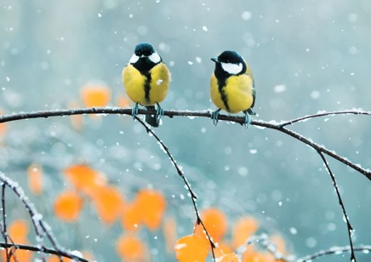
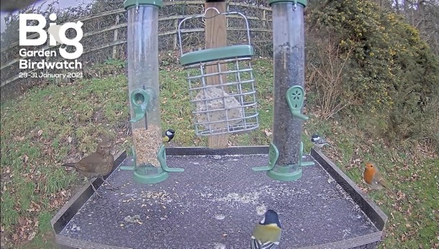
The Main Event!
If your garden isn’t very chirpy – don’t worry!
Click here to find the Big Garden Bird Watch live webcam
https://www.youtube.com/watch?v=z2YXRazll4Y
How many birds can you count on the webcam ?
How many birds can you see here?
Which was your favourite bird?
What do you think the birds are eating?

Slide 6
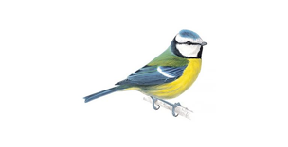
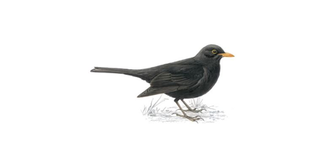
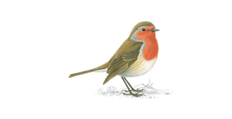
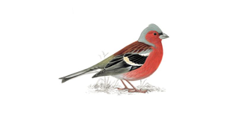
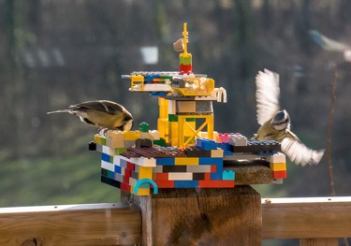
How to take part in the survey…
Count the birds from one place, for one hour
1 Pick a time
You can choose any hour between Friday 29th and Sunday 31st January 2021. So whether you’re an early bird or a night owl, you can still take part.
2 What did you see?
Count the birds you see in your garden, from your balcony or window. To avoid double-counting, just record the highest number of each bird species you see at any one time – not a running total.
TOP TIP: Put some bird food out a few days before you count the birds
*This year our advice is to take part in the safety of your own home*
3 Submit your results
Online: You can submit your results online at https://www.rspb.org.uk/get-involved/activities/birdwatch/ from 29 January until 19 February.

Slide 7
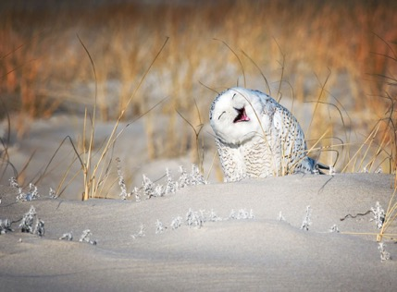
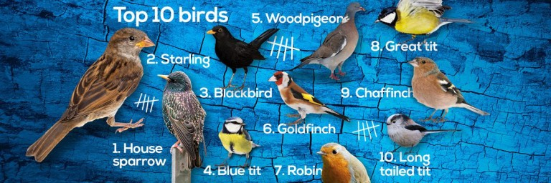
Whose t-who?...
By looking at colours, shape and size we can name the birds we see.
Can you name the birds in your garden or on the live webcam?
Which bird is the biggest here?
Which bird has a red/ orange chest?
Are you able to draw the birds that you have seen? What colours will you use?

Slide 8
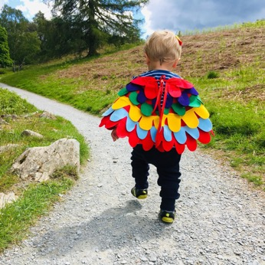
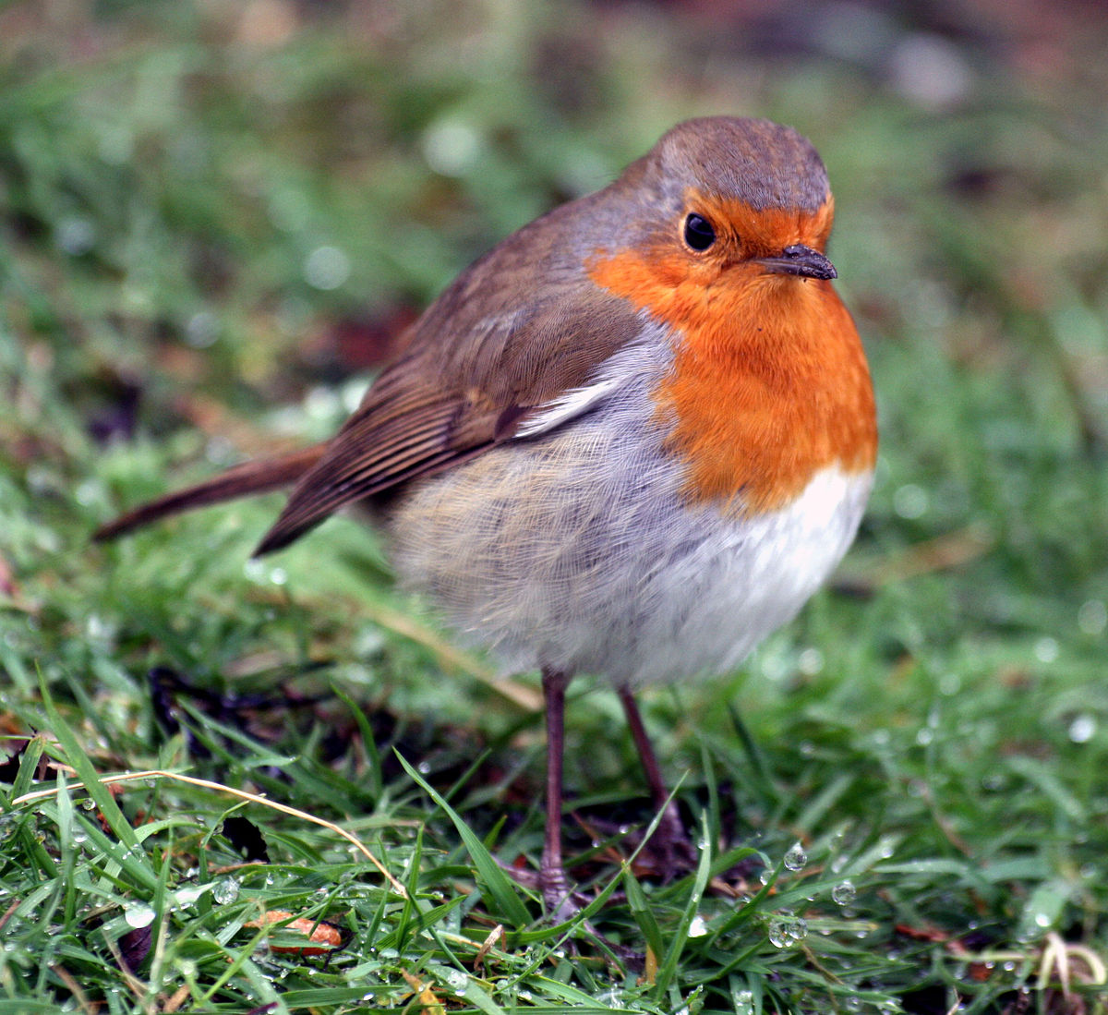
Mindfulness Moment
Watch and listen to the birds and other wildlife
Find a nice spot to sit (outside in morning or dusk if possible!)…
Can you Find…
5 birds that you can see?
Can you imagine that you are a bird? How would you feel with wings?
4 birds that you can hear?
3 places a bird could perch?
2 places a bird could hide?

Slide 9
How did you get on?
What was your favourite activity?

