Slide 1
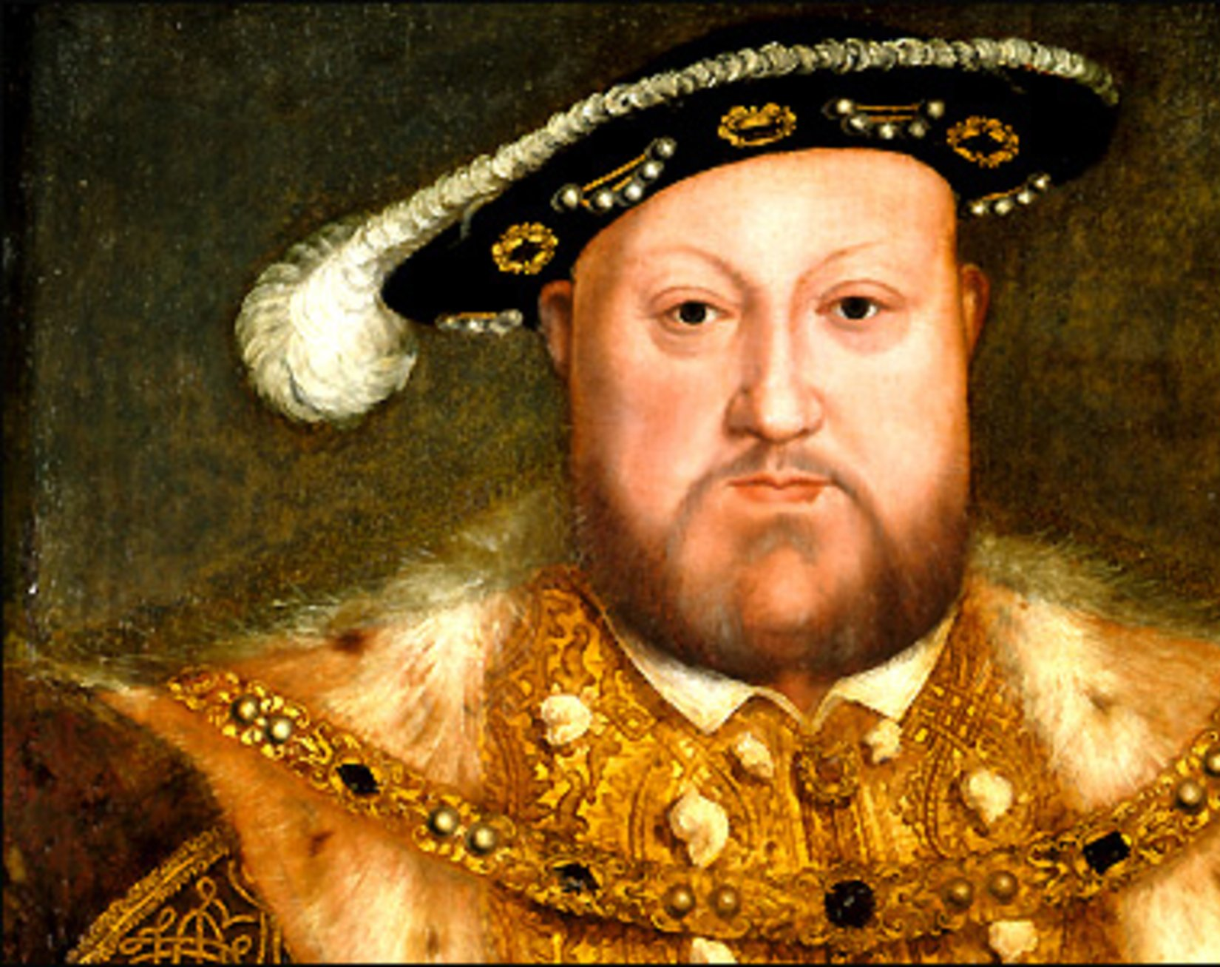
Henry VIII and his 6 wives
By Niamh Haresceugh – Jones
Yr 6

Slide 2
Who was he and why was he so famous?

Slide 3
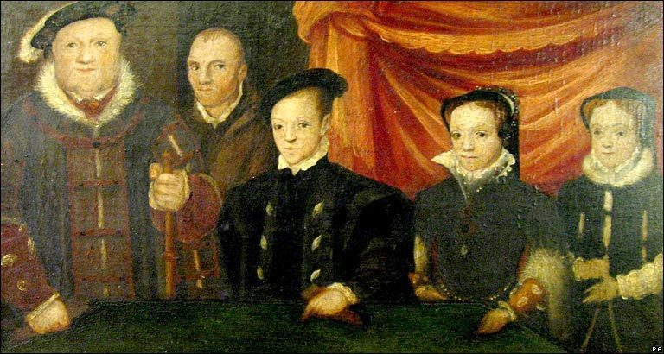
King Henry VIII (1491-1547) ruled England for 36 years, presiding over sweeping changes that brought his nation into the Protestant Reformation. He famously married a series of six wives in his search for political alliance, marital bliss and a healthy male heir. His desire to annul his first marriage without papal approval led to the creation of a separate Church of England. Of his marriages, two ended in annulment, two in natural deaths and two with his wives’ beheadings for adultery and treason. His children Edward VI, Mary I and Elizabeth I would each take their turn as England’s monarch.

Slide 4
Early life

Slide 5
Henry was born on June 28, 1491, the second son of Henry VII, the first English ruler from the House of Tudor. While his older brother Arthur was being prepared for the throne, Henry was steered toward a church career, with a broad education in theology, music, languages, poetry and sports.
Did you know? An accomplished musician, Henry VIII of England wrote a song entitled "Pastime With Good Company" that was popular throughout Renaissance Europe.
Arthur had been betrothed since age 2 to Catherine of Aragon, the daughter of the Spanish rulers Ferdinand and Isabella, and in November of 1501 the teenage couple were married. Months later, Arthur died of a sudden illness. Henry became next in line for the throne and in 1503 was betrothed to his brother’s widow.

Slide 6
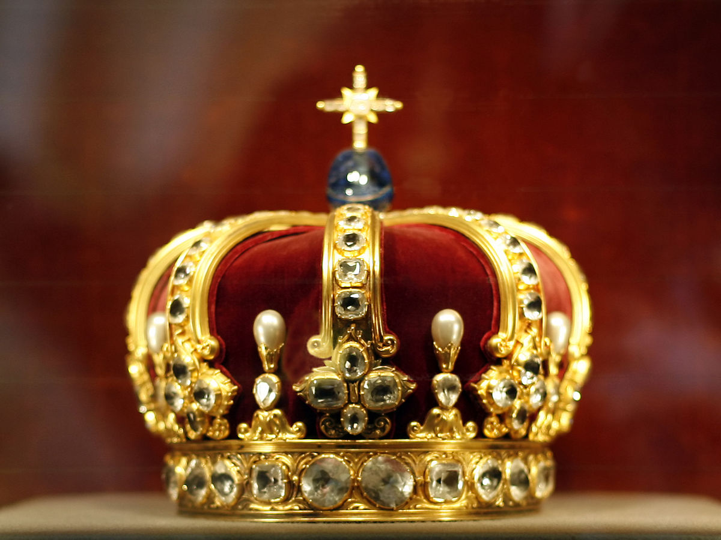
First year as King

Slide 7
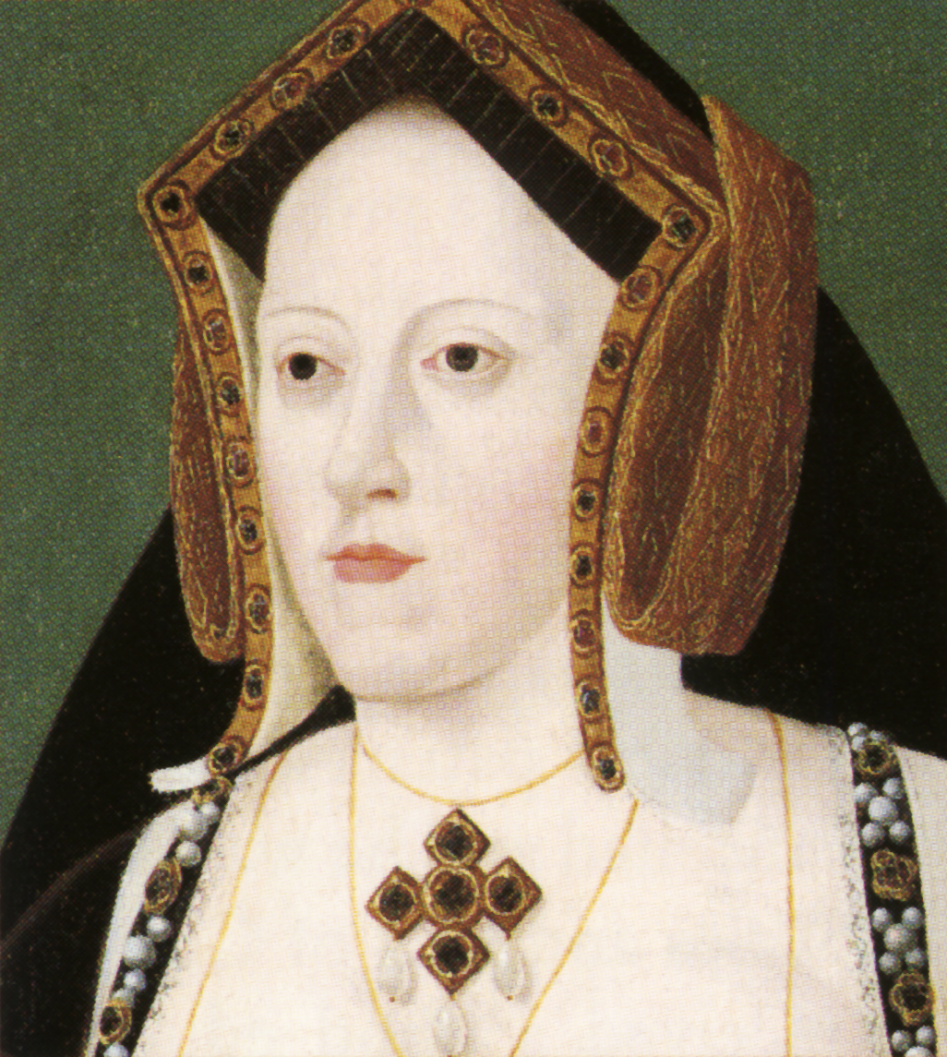
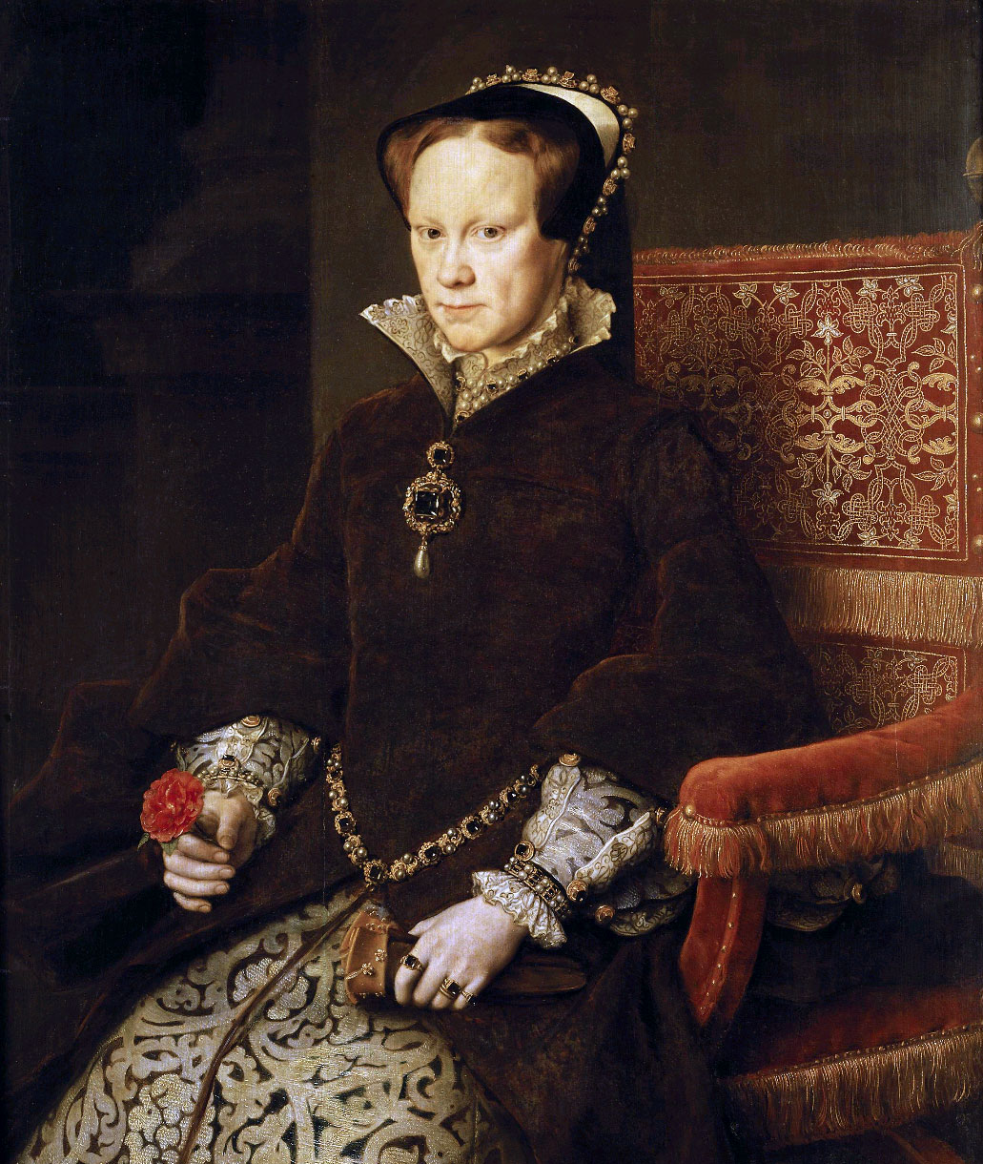
Henry VIII took the throne at age 17 and married Catherine of Aragon six weeks later. Over the next 15 years, while Henry fought three wars with France, Catherine bore him three sons and three daughters, all but one of whom died in infancy. The sole survivor was Mary (later Mary I), born in 1516.
Henry was an active king in those years, keeping a festive court, hunting, jousting, writing and playing music. He issued a book-length attack on Martin Luther’s church reforms that earned him the title “Defender of the Faith” from Pope Leo X. But the lack of a male heir—especially after he fathered a healthy illegitimate son, Henry FitzRoy, in 1519—gnawed at the king.

Slide 8
Dissolving a Marriage, Splitting the Church

Slide 9
By the 1520s, Henry had become infatuated with Anne Boleyn, a young woman in his wife’s entourage. He also worried that his marriage to Catherine had been cursed by God because of the Old Testament ban on marrying the widow of one’s brother. The king decided to seek a papal annulment that would free him to remarry.
With the assistance of his powerful adviser Cardinal Wolsey, Henry petitioned Pope Clement VII but was rebuffed due to pressure from Catherine’s nephew, the Holy Roman Emperor Charles V. Wolsey was forced from power for his failure and died in 1530 awaiting trial for treason.
With the backing of the English parliament and clergy, Henry ultimately decided that he didn’t need the pope’s permission to rule on issues affecting the Church of England. In 1533 Henry and Anne Boleyn were married, and their daughter Elizabeth was born. Mary was declared illegitimate and Elizabeth named his heir. England’s monasteries were closed and in most cases sold off to add to Henry’s wealth.

Slide 10
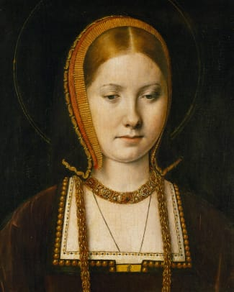
More Marriages and Deaths

Slide 11
In January of 1536 Henry was unhorsed and injured during a jousting tournament. When news of his accident reached the pregnant Anne, she miscarried, delivering a stillborn son. Henry then spurned her, turning his affections to another woman of his court, Jane Seymour. Within six months he had executed Anne for treason and incest and married Jane, who quickly gave him a son (the future Edward VI) but died two weeks later.
Henry’s fourth marriage bore similarities to his first. Anne of Cleves was a political bride, chosen to cement an alliance with her brother, the ruler of a Protestant duchy in Germany. The marriage only lasted a few days before Henry had it annulled. He then married Catherine Howard, but two years later she too was beheaded for treason and adultery.
In the last years of his reign Henry grew moody, obese and suspicious, hobbled by personal intrigues and by the persistent leg wound from his jousting injury. His final marriage, to the widow Catherine Parr in 1543, saw his reconciliation with Mary and Elizabeth, who were restored to the line of succession.

Slide 12
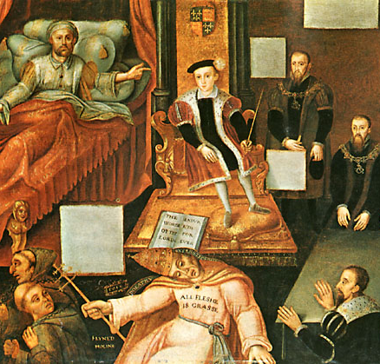
Death and Legacy

Slide 13
Henry VIII died at age 55 on January 28, 1547. His 9-year-old son Edward VI succeeded him as king but died six years later. Mary I spent her five-year reign steering England back into the Catholic fold, but Elizabeth I, the longest-reigning of the Tudor monarchs, re-entrenched her father’s religious reforms.

Slide 14
The end
By Niamh Haresceugh – Jones
Yr 6

