Slide 1
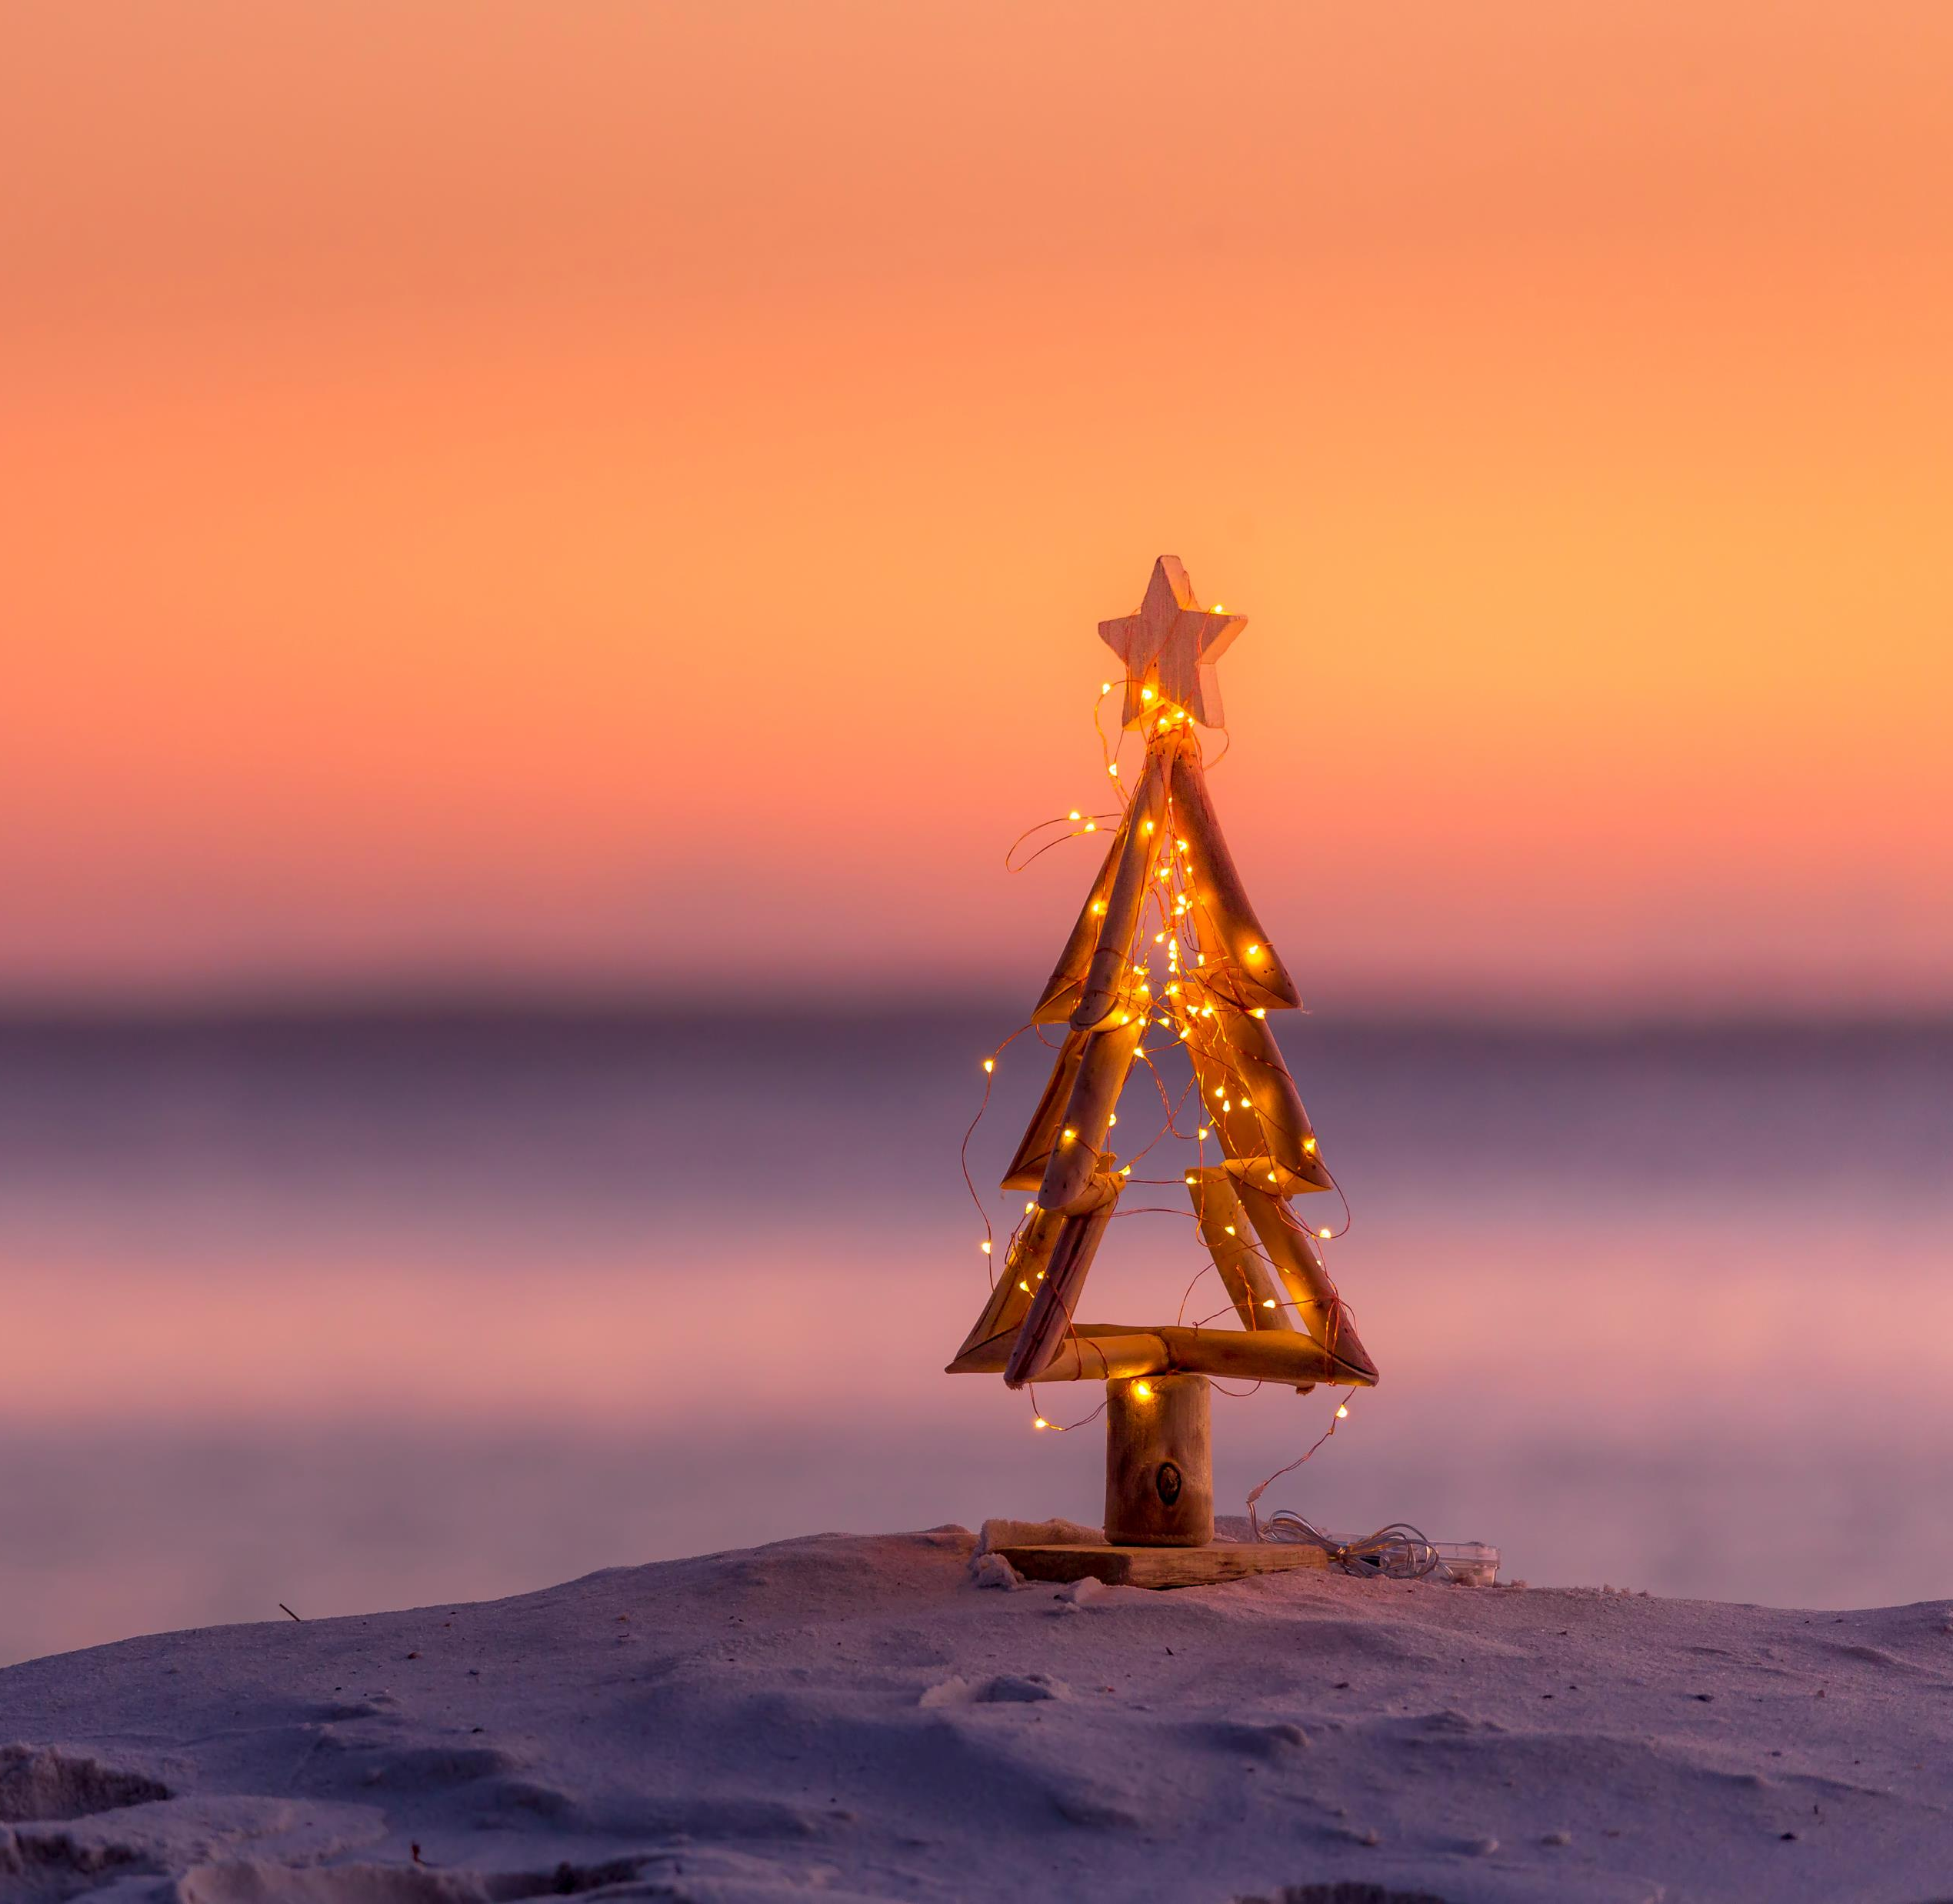
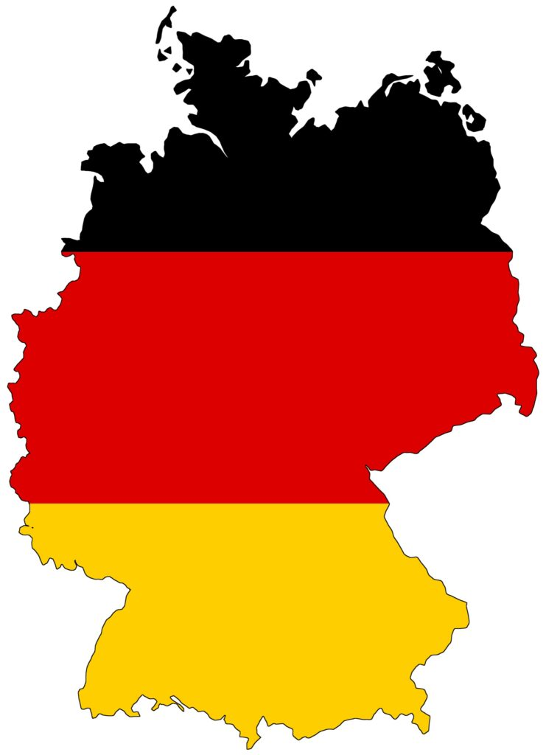
Christmas around the world
Germany

Slide 2
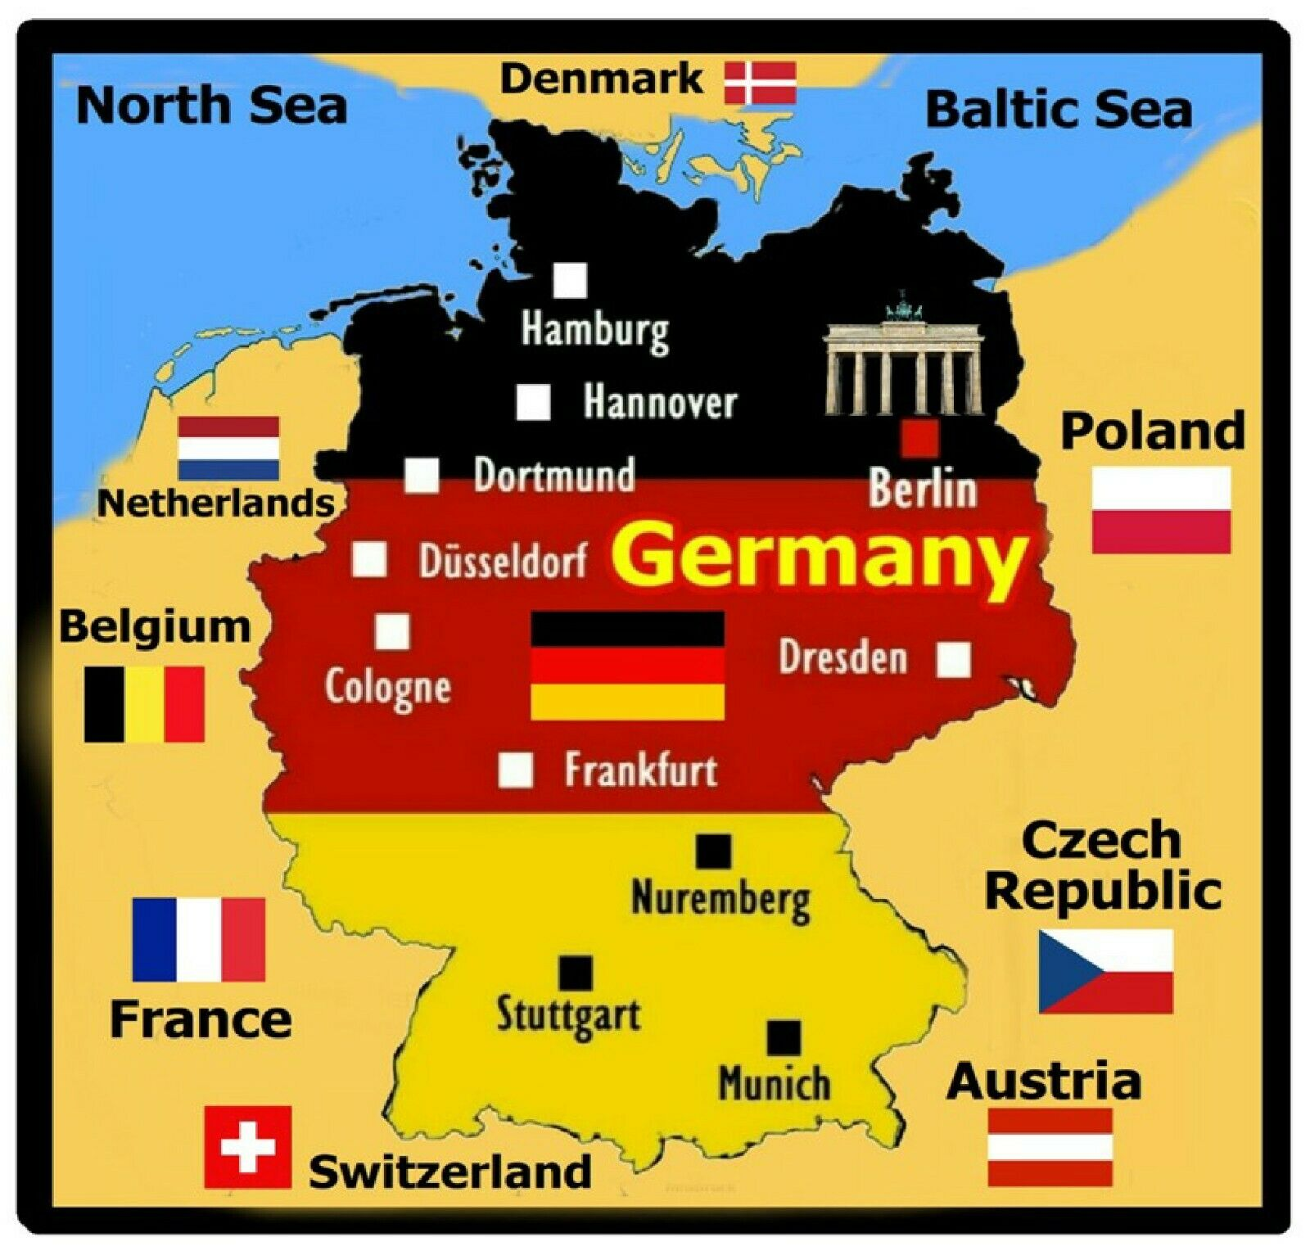
Fun facts!
Germany is located in the North-eastern hemisphere within Europe.
Germany has two seas, the Baltic sea and north sea

Slide 3
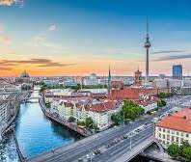
Germany’s capital city is Berlin.
Its people speak German.

Slide 4
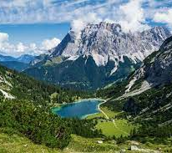
Germany’s highest mountain is Zugspitze
The Rhine is the longest river in Germany

Slide 5
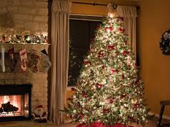
Christmas traditions in Germany
Christmas trees are only decorated on Christmas Eve in Germany.
One in two house holds set up a Nativity scene.
Gifts are exchanged on the 24th of December.

Slide 6
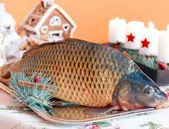
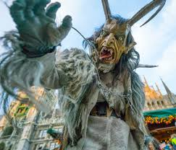
Germans eat food after opening gifts including Carp and Potato salad
Frohe Weihnachten means Merry Christmas in German
As well as Father Christmas German’s have The Krampus who is a horned creature who scares badly behaved children at Christmas time.

Slide 7
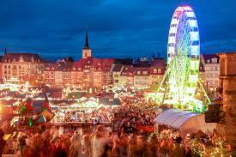
A German Christmas by Evie-Mae Doran
Merry Christmas everyone!

