Slide 1
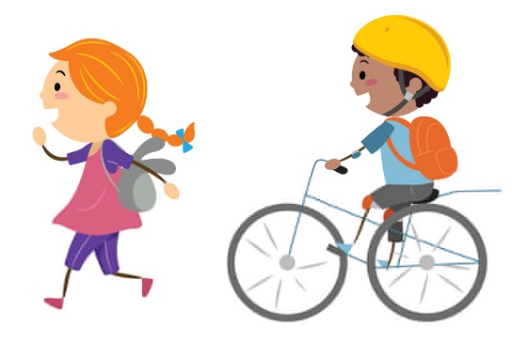
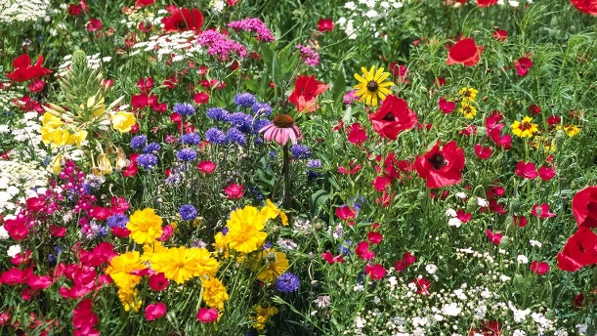
Look after all of our trees, please!
Turn off the lights,
do it right!
Reduce, reuse, recycle!
Turn off computers and projectors after use.
Can you walk or cycle to school?
Broadbent Fold’s Eco Code
Put fruit and vegetable waste in the compost bin
Plant wild flowers, don’t pick them!
Use the bins to do good things!
Recycle paper, plastic and glass in the correct bins.

