Slide 1
ANGLO SAXONS CRIME AND PUNISHMENT.
BY NIAMH.
YR5.

Slide 7
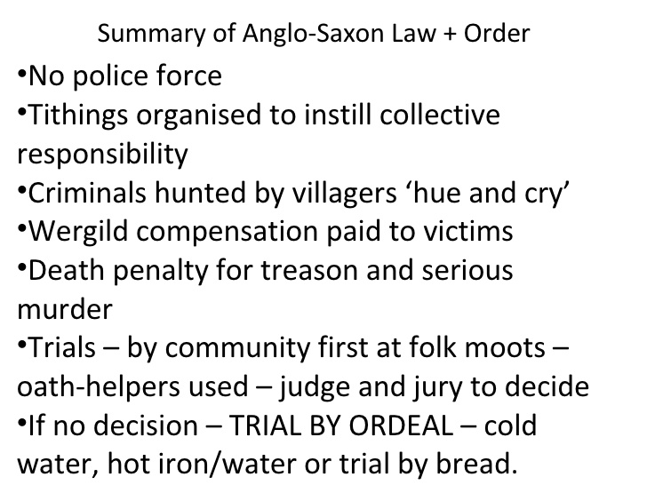

Slide 8
THE END

